Slide 1
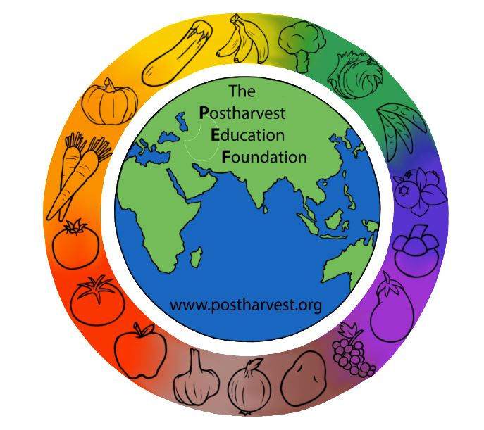
Reducing Postharvest Losses in Sub-Saharan Africa: Training for extension workers, technical specialists and practitioners
The Postharvest Education Foundation
2023
Slide set for Manual 1. ISBN: 978-1-62027-026-4
Module 1.1

Slide 2
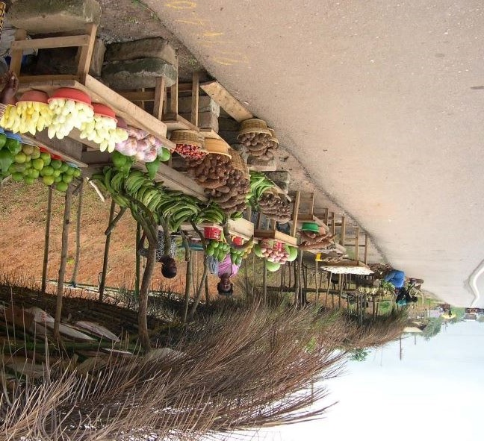
Module 1.1.9 Overview: Sub-Saharan Africa - Reducing Postharvest Losses
Learning objectives for practitioners
To be aware of topics or areas of training/extension and advocacy that are needed to solve postharvest problems for a variety of crops/food products in the 3 food groups
To gain an understanding of the many options available for addressing the causes of postharvest losses identified in food loss assessments.
Mod. 1.1 Slide 1

Slide 3
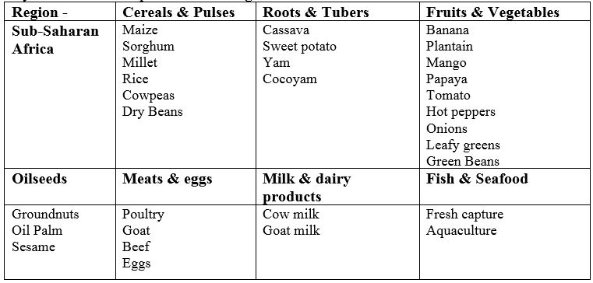
Key foods that are important for the region
Mod. 1.1 Slide 2

Slide 4
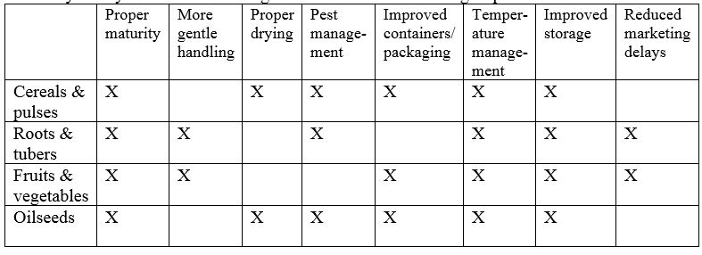
Summary of key factors for reducing postharvest losses
Mod. 1.1 Slide 3

Slide 5
General overview of postharvest loss reduction practices
Proper maturity at harvest
More gentle handling of perishable crops to reduce damage
Proper drying of cereals and pulses before storage
Postharvest pest management
Improved containers or packaging
Temperature management/cooling and cold storage for perishable foods
Improved storage for cereals and pulses
Market access
Supply chain efficiency as a goal
Mod. 1.1 Slide 4

Slide 6
Proper maturity at harvest
Harvesting too early:
If fruits are harvested too early they will lack flavor, and may not be able to ripen.
Harvesting too late:
If root crops are left in the field too long, they can become fibrous or pithy (with poor eating quality)
If cereals are left on the plant too long after full maturity, some of the grains can drop off and be lost during the harvest (shatter).
Mod. 1.1 Slide 5

Slide 7
More gentle handling of perishables to reduce damage
Rough handling occurs during all segments of the food supply chain:
Digging damage to R&T crops
Harvest wounds for F&V crops
Bruises from dropping, throwing, tall heaps
Compression damage from use of poor quality containers
Stepping on produce during loading/unloading
Mod. 1.1 Slide 6

Slide 8
Proper drying of cereals and pulses before storage
Cereals and pulses that are put into storage at higher than recommended moisture content will be more susceptible to fungal attack and mold damage.
Mod. 1.1 Slide 7

Slide 9
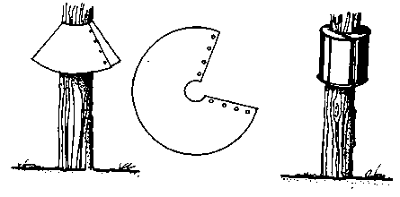
Postharvest pest management
Postharvest pest management includes:
Insect control
Decay control
Rodent control
Rat guards fashioned from metal sheeting or empty cans. Source: FAO. 1985.
Mod. 1.1 Slide 8

Slide 10
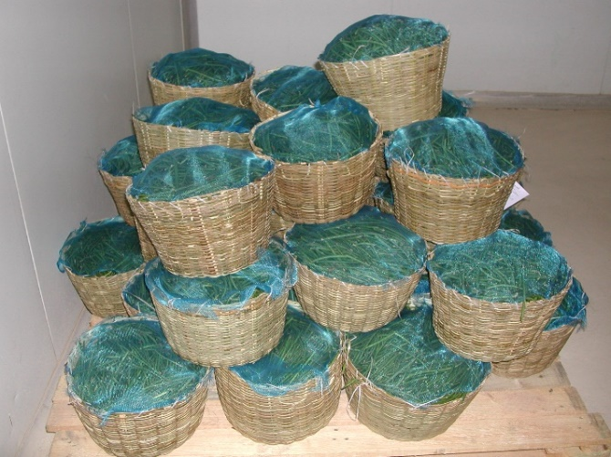
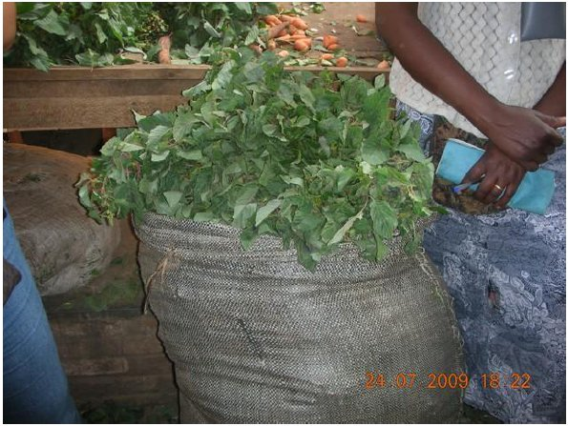
Improved containers or packaging
Protecting food crops from damage is one of the key purposes of a package or container.
Handling foods in poor quality packages and containers such as bundles, sacks or baskets leads to damage, spillage and deterioration.
Green beans shipped in baskets from Benin to Ghana (Photo credit: Lisa Kitinoja); Leafy greens in sacks in Rwanda (Photo credit: S K Roy).
Mod. 1.1 Slide 9

Slide 11
Temperature management for cereals and pulses
The postharvest storage potential for harvested grains and pulses (cowpeas, dry beans, lentils) is longer when the crops are stored at lower temperatures.
The allowable storage time (AST) for grains is reduced by approximately one-half for each 6°C increase in grain temperature.
Mod. 1.1 Slide 10

Slide 12
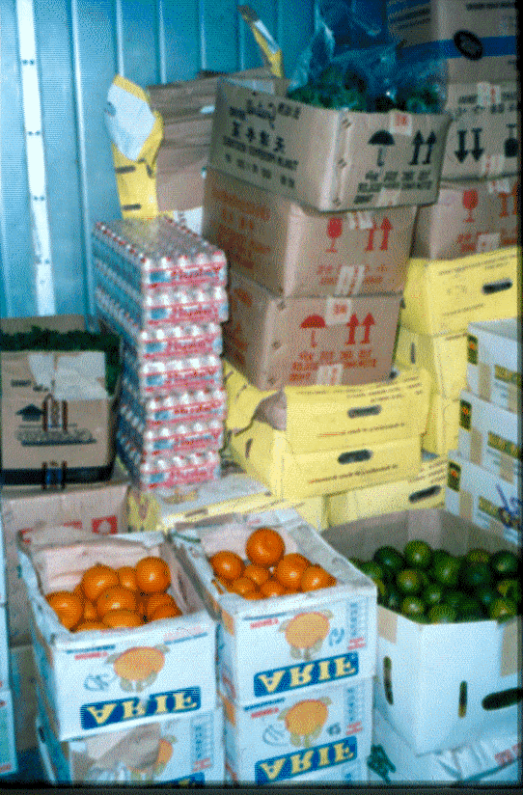
Cooling and cold storage for perishable foods
Temperature control has been found to be the most important factor in maintaining fresh produce quality.
Fruits and vegetables are living, breathing tissues separated from their parent plant.
Keeping F&V crops at their lowest safe temperature (0-2°C for temperate crops or 12-15°C for chilling sensitive crops) will increase storage life by lowering respiration rate, decreasing sensitivity to ethylene gas and reducing water loss.
Cold rooms should not be overloaded, and incompatible crops should not be stored together.
Mixed loads in cold storage in Cape Verde (Photo credit: Lisa Kitinoja)
Mod. 1.1 Slide 11

Slide 13
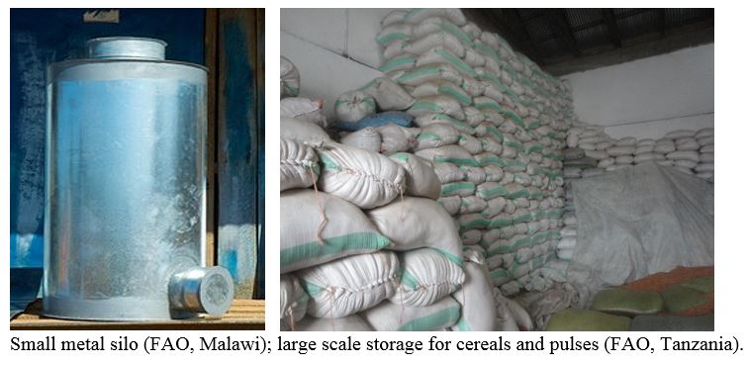
Improved storage for cereals and pulses
Investments in improved structures and storage management practices will keep the crops clean, dry and protected from pests.
Mod. 1.1 Slide 12

Slide 14
Market access and supply chain efficiency
Reducing marketing delays for perishable crops and improving market information systems for all food crops can help to reduce postharvest losses.
Small-holder farmers are often dependent upon traders to visit the farm and pick up harvested produce to transport it to market. If the produce is perishable, a delay can result in lower quality and a long delay can result in a complete loss.
For crops that can be stored for long periods of time, knowing the cost of storage, the cost of transport and the market prices in a range of local and regional markets can help farmers, traders and wholesalers determine when and where to sell the crops.
Mod. 1.1 Slide 13

Slide 15
End of Module 1.1 (Overview)
The next three Modules in Manual 1 provide details and examples of improved postharvest handling practices and cost-effective postharvest technologies for reducing losses in cereals & pulses, roots and tuber crops, and fruits and vegetables.
Practitioners will learn how to select from the range of potential options for reducing food losses and consider each of the following:
technical fit (scale of the technology, suitability for the crop)
costs and expected benefits
potential environmental impacts (energy use, pollution, etc.)
related social issues (gender issues/roles, ethnicity, youth access, etc.)
policy framework (does it fit into the existing system?, does the intervention have any support?)
food safety issues.
Mod. 1.1 Slide 14

