Slide 1
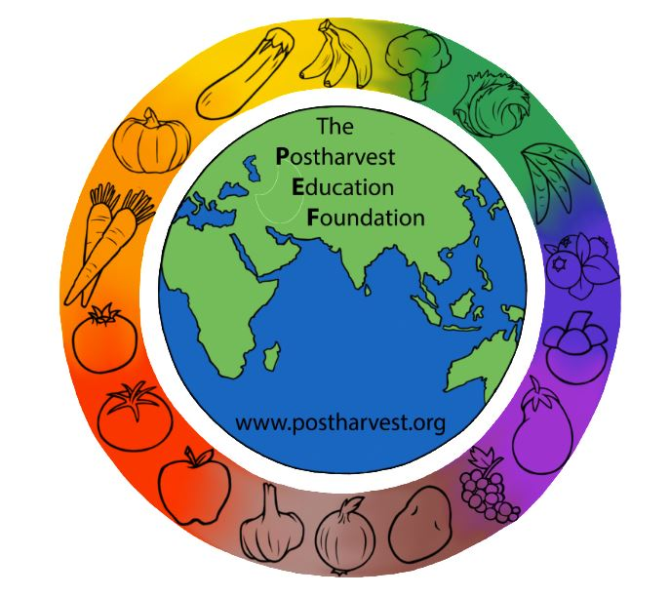
Reducing Postharvest Losses in Sub-Saharan Africa: Training for extension workers, technical specialists and practitioners
The Postharvest Education Foundation
2023
Slide set for Manual 1. ISBN: 978-1-62027-026-4
Module 1.2

Slide 2
Module 1.1.10 Reducing Postharvest Losses in SSA: Cereals and Pulses
Learning objectives for Practitioners:
to gain an understanding of the many options available for addressing the causes of food losses identified in food loss assessments (FLA) for cereals and pulses.
to be introduced to key postharvest technologies, improved handling practices and management skills that can help the 5 beneficiary groups reduce postharvest food losses for cereals and pulses
to be able to use a simple worksheet to calculate the local costs and expected benefits for any new or improved practice or technology by estimating relative changes in comparison to the current practice or technology
to be made aware of topics or areas of training/extension and advocacy that are needed to solve postharvest problems for a variety of cereals and pulses
Mod. 1.2 Slide 1

Slide 3
Key crops for SSA
Maize
Sorghum
Millet
Rice
Cowpeas
Dry Beans (Phaseolus)
Mod. 1.2 Slide 2

Slide 4
5 segments of cereals & pulses (C&P) supply chains
(1) harvesting & postharvest handling (on-farm)
(2) storage
(3) transportation
(4) agro-processing
(5) wholesale and retail
The majority of the total of 18.5m tonnes per year of losses for cereals in SSA occur during production/harvesting (4.6 million tonnes), during postharvest handling and storage (6.1m tonnes) and during processing/packaging (6.2m tonnes). Source: Gustavsson et al., 2013.
Mod. 1.2 Slide 3

Slide 5
Reducing food losses during (1) harvesting & postharvest handling on-farm
Making improvements in the following six on-farm activities will have a positive impact on postharvest losses of C&P crops.
Harvest indices
Cutting
Threshing/Shelling
Cleaning
Field drying
Bagging or bulking
Mod. 1.2 Slide 4

Slide 6
Harvest indices and Cutting
Knowing when to harvest is critical for producers of C&P crops.
For example, for rice, grain moisture content ideally is between 20 and 25% (wet basis). Grains should be firm but not brittle when squeezed between the teeth, and 80−85% of the grains have turned yellow-colored (like dried straw).
Harvesting should be done when there is minimal surface moisture (e.g. from previous rainfall or early morning dew).
Harvesting rice too early results in a larger percentage of unfilled or immature grains, which lowers yield and causes higher grain breakage during milling.
Harvesting too late leads to excessive losses and increased breakage in rice during threshing and milling.
Mod. 1.2 Slide 5

Slide 7
Moisture content at harvest
For maize, moisture content at harvest is a critical factor. Mature grain has a harvest index of 30% moisture. Losses will tend to increase as moisture content decreases if the mature maize cobs are left on the plant.
If cereal crops are harvested at the proper moisture content, there will be less missing grain after cutting/harvesting.
Mod. 1.2 Slide 6

Slide 8
Threshing or shelling
Maize should be husked before shelling, and any decayed cobs should be sorted out and removed from the load.
In Ethiopia, Mercy Corps is promoting a variety of different types of maize shelling technologies for different type of target groups, each with different needs and resources.
Mod. 1.2 Slide 7

Slide 9
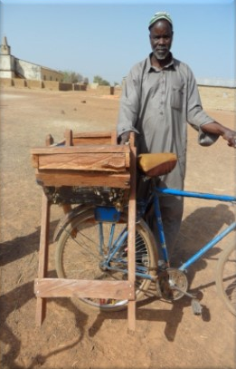
Reducing damage caused by traditional threshing practices
Beating C&P crops with sticks, trampling them with animals, or rolling heavy objects over the crops are traditional methods used for threshing.
In Ethiopia, 75% of rice grains are damaged via on-farm threshing practices.
Any threshing method that is more gentle than traditional threshing will help to reduce postharvest losses for C&P crops.
Pedal powered thresher (Photo credit: Sasakawa Africa Association)
Mod. 1.2 Slide 8

Slide 10
Par-boiling rice
A simple innovation that can further reduce losses is par-boiling and drying the grains before threshing, which has been shown to reduce losses to less than 2% in Ethiopia.
Par-boiling is popular in West Africa, and is a relatively new practice in East Africa.
Aspects of local acceptance and palatability is an issue to be considered.
For full details and resources, please refer to Manual 1, p.13
Mod. 1.2 Slide 9

Slide 11
Cleaning and field drying
Cleaning the threshed grains properly and drying the grains immediately after threshing will help to reduce postharvest losses.
Any decayed grains (discolored, moldy) should be sorted out and removed, and the crop should be properly dried before further handling.
This will prevent decay organisms from spreading to the rest of the crop.
Mod. 1.2 Slide 10

Slide 12
Aflatoxin management
Aflatoxins can be a problem in dried C&P crops if they are not properly dried and protected from moisture during storage and marketing.
A highly toxic metabolite produced by the ubiquitous Aspergillus flavus fungus is a major public health issue in Africa.
IITA studies measured contamination in 30 to 65% of stored maize (also a problem in sorghum, rice, millet, groundnuts, and dried R&T crops).
The fungus infects crops in the field and produces the toxin in the field and in stores, then the fungus is carried from field to store.
Contamination is possible without visible signs of the fungus, and very low levels are toxic (maximum allowable levels = 20 ppb US; 10 ppb WFP; 4 ppb EU).
Mod. 1.2 Slide 11

Slide 13
Some predisposing factors for aflatoxin contamination
pre-harvest high night-time temperatures and drought stress
wet conditions at harvest and post-harvest periods
insect or bird damage
rain on the mature crop increases contamination.
associated with high humidity in the field & store, insect damage, and improper crop storage or transportation.
Source: PACA and IITA http://www.aflatoxinpartnership.org
Mod. 1.2 Slide 12

Slide 14
Bagging or bulking
Spillage is a source of postharvest losses during the transport of C&P crops from the field to the storage structure or the market.
Careful bagging practices (slow, steady) and taking care not to tear the bags when handling them can help to reduce losses.
Using a ground cloth under heaps and inside a vehicle bed can help reduce losses when carrying bulk loads.
Covering the loads if they are on open trucks can reduce spillage and protect from rain and contamination from dust, insects and birds.
Mod. 1.2 Slide 13

Slide 15
Reducing postharvest losses during (2) storage
Mechanical drying
Temperature and relative humidity control
On-farm storage structures and storage management
Hermetic storage
Mobile storage
Commercial storage / warehouse management
Insect control
Sanitation and inspection
Mod. 1.2 Slide 14

Slide 16
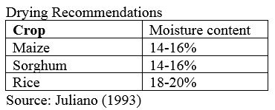
Mechanical drying
Solar radiation is usually used to dry cereals and pulses, particularly in the dry season. Drying capacity is limited in the wet season.
Adding heat to the load of cereals or pulses during drying can speed the process and result in a more uniformly dried product.
If the crops are harvested during the rainy season, heat assisted drying can be particularly important to prevent postharvest losses in storage.
Heat can be generated by a wide range of sources, including wood or charcoal fire, electric or diesel powered heaters, or solar power.
Mod. 1.2 Slide 15

Slide 17
Types of dryers
There are many types of mechanical driers for C&P crops.
natural air = no heat added, perforated floor (1 cm²/30 cm²), electric fan pushes outside air under floor and through the grain, exhaust opening at top of bin
low heating = small amount of added heat to reduce RH% of air, same as above specs, usually with a gas-powered heater, electric fan
batch-in-bin = 1 meter layer of grain in a bin with a perforated floor, requires adding heat, fan for air flow, and stirring the grain during drying
high temperature = added heat, works best with continuous flow type dryers
Mod. 1.2 Slide 16

Slide 18
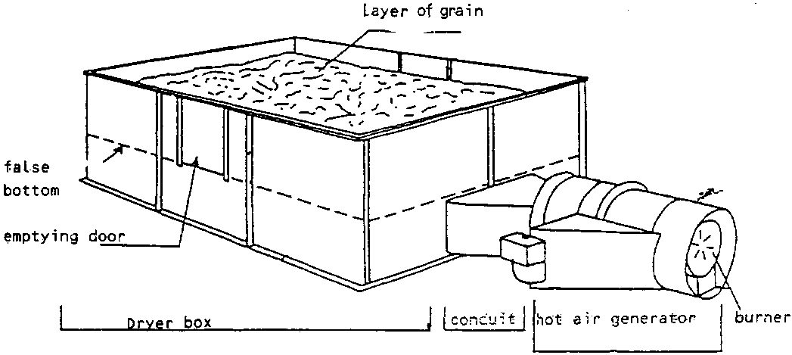
Examples of driers for C&P crops
Heat assisted dryer with false bottom and perforated floor (Source: FAO 1994)
Natural air drying in a 3 meter deep bin, where the drying zone is 30 to 60cm in depth near the center of the load. (Source: www.extension.umn.edu)
Mod. 1.2 Slide 17

Slide 19
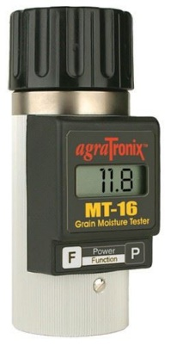
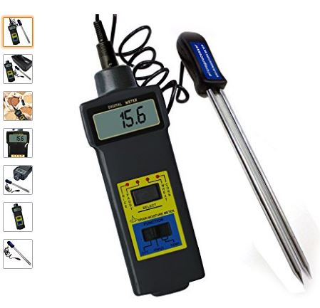
Measuring moisture content
Grain Moisture Testers (resistance type)
Mod. 1.2 Slide 18

Slide 20
Temperature and relative humidity control
Keeping the C&P crops cool and dry will help to increase storage life and reduce postharvest losses.
The allowable storage time for grains is reduced by approximately one-half for each 6°C increase in grain temperature.
Allowable storage time (AST) of 13% moisture maize:
about 9 months at 15°C
about 5 months at 21°C
only 3 months at 27°C
Mod. 1.2 Slide 19

Slide 21
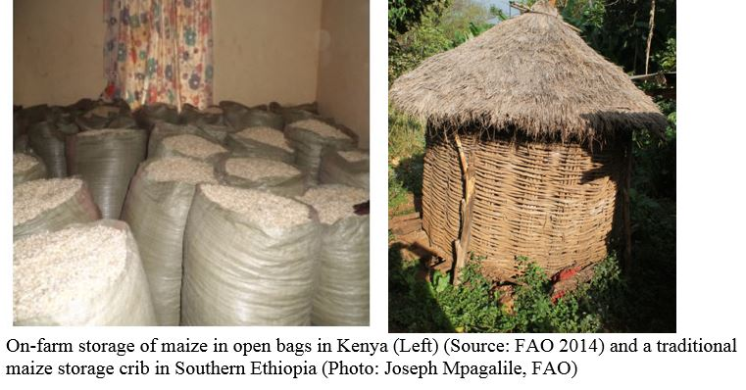
On-farm storage structures and storage management
The traditional storage practices for maize in Kenya observed during the FLA (FAO 2014) were examples of the type of practices that can be improved by proper management.
Mod. 1.2 Slide 20

Slide 22
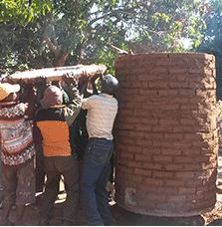
“Gorongosa silos”
Can be more affordable than metal silos, and are based on locally developed technology.
Made mainly of mud and clay bricks, with a supporting structure of cement and iron rods, these silos can last for up to 20 years with good maintenance.
Typical maize losses of 30% experienced in Mozambique can be decreased to less than 5%, and maize can be stored for up to 10 months.
Gorongosa silo for maize storage.
Source: http://www.fao.org/in-action/improved-post-harvest-handling-raises-incomes-for-mozambique-farmers/en/
Mod. 1.2 Slide 21

Slide 23
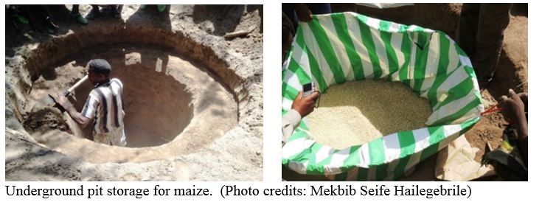
Underground pit storage
The combination of underground (cool) and plastic container (dry) is being used for improved maize storage in Ethiopia.
The pit is lined with heavyweight plastic tarpaulins, sealed and covered to prevent damage from insects, rodents, fire and moisture.
Postharvest losses were reduced to less than 1% after 6 months of storage.
Underground storage is very risky and difficult to monitor and is not recommended as a household level storage solution
Mod. 1.2 Slide 22

Slide 24
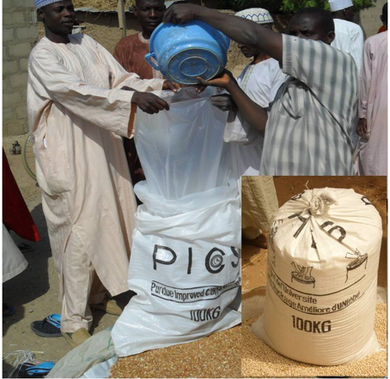
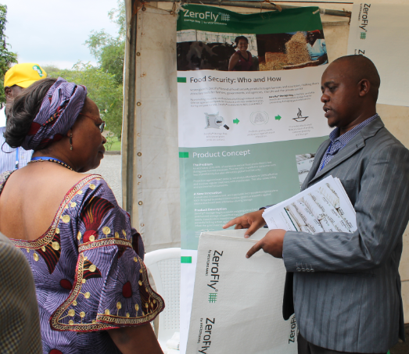
Hermetic storage
Storage of dried cereals and pulses can be extended by excluding oxygen and moisture.
Hermetic storage bags or structures do this by sealing out light, air, water and pests.
Cowpea storage in PICS bags in Nigeria for 6 months (SSA 2014)
PICS bags being demonstrated in Nigeria (Left). (Photo credit: Sasakawa Africa Association) and a Zero fly bag (Right) being promoted during an event in Ethiopia (FAO) (Photo credit: Joseph Mpagalile FAO).
Mod. 1.2 Slide 23

Slide 25
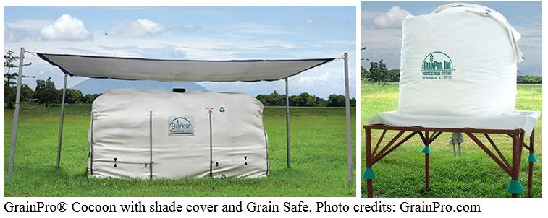
“Cocoons” for hermetic storage
“Cocoons” are used for hermetic storage of larger quantities of C&P crops.
The crops are in sacks and stacked inside the water-proof and airtight cocoon for long term storage.
A unit can store from five to 300 tonnes of cereals or pulses for up to one year with minimal postharvest losses – typically, less than 1% (GrainPro.com).
Mod. 1.2 Slide 24

Slide 26
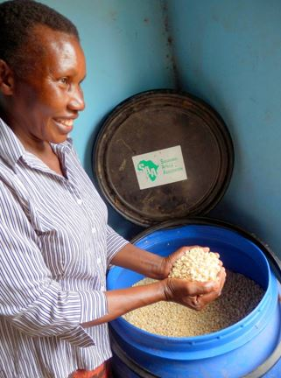
Silos made of plastic, metal or cement
Metal silo promoted by FAO in Malawi (left) and a silo made from a plastic water barrel in Uganda (right; Photo credit: Sasakawa Africa Association).
Mod. 1.2 Slide 25

Slide 27
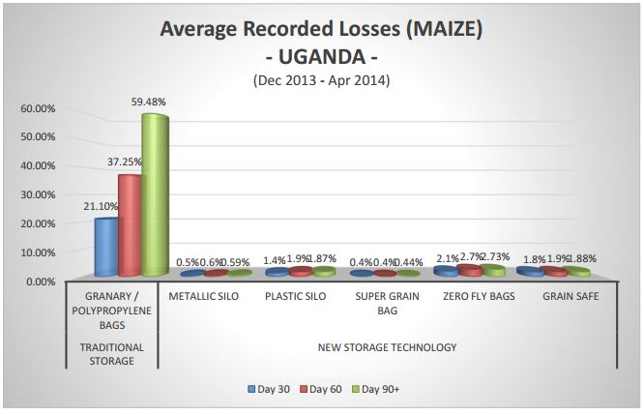
Reducing losses in storage: maize in Uganda
Any of the improved technologies that have been described for on-farm storage will help to reduce losses when compared to traditional storage practices.
WFP studies have documented that losses of maize in Uganda can be reduced to as low as 1 to 2% by using silos or improved storage bags (WFP 2014).
Mod. 1.2 Slide 26

Slide 28
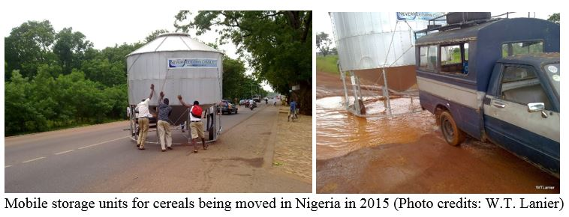
Mobile storage
Storage silos can be constructed on wheels, to enable the users to move them to where they are needed. In Nigeria is it possible to rent a mobile storage unit and have it delivered to the farm or marketplace.
Mod. 1.2 Slide 27

Slide 29
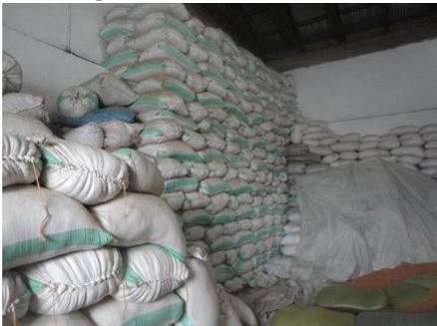
Commercial storage / warehouse management
Large scale storage of C&P crops in SSA is commonly found in large cities, where sacks of cereals or pulses are kept in government owned or commercially managed warehouses.
Common problems that lead to postharvest losses include:
Failure to enforce quality standards at intake
Poor temperature management
Poor sanitation
Poor pest management practices
Lack of inspection and removal of damaged/decayed product
Poor inventory management
Large scale storage in Tanzania. Photo credit: Joseph Mpagalile.
Mod. 1.2 Slide 28

Slide 30
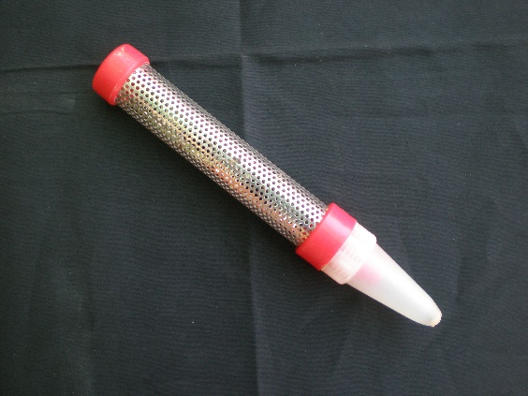
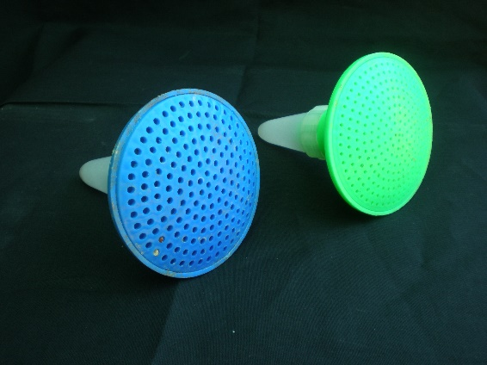
Insect control
Postharvest pest management requires knowledge of what type of pests are causing problems and what types of control measures are available to control them.
Sampling for insect pests and setting traps can provide useful information and lead to improved pest control.
Probe trap (left) and Pitfall trap (right): Stored grain insect traps Photo Credits: S. Mohan
Mod. 1.2 Slide 29

Slide 31
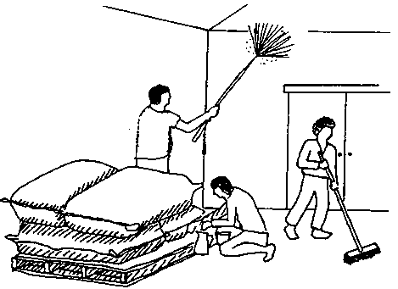
Sanitation and inspection
A simple broom is the most useful piece of pest control equipment in a warehouse that is used for food grains and processed foods.
The prompt removal of spillage prevents insect populations developing in cracks and crevices from where they can infest the stored foods (Walker and Farrell 2003).
Cleaning the storage room (Source: FAO 1985)
Mod. 1.2 Slide 30

Slide 32
Reducing postharvest losses during (3) transportation
Traders are generally in charge of postharvest handling during transportation.
Traders are rarely included in postharvest extension/training programs, and they can be a difficult clientele group to reach, since they are usually on the move from farm to farm and market to market, and rarely have time to attend long meetings or classroom style educational programs.
Training on improved practices should include:
Loading/unloading
Covers for bulk loads
Use of strong and durable sacks/bags
Mod. 1.2 Slide 31

Slide 33
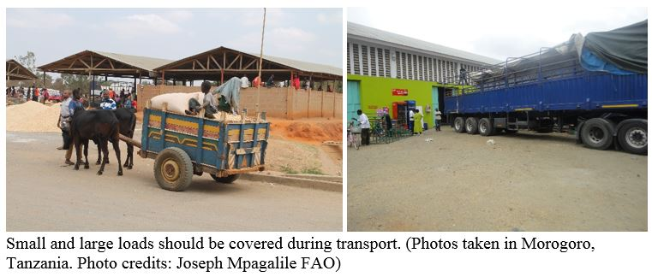
Reducing losses during transportation
Loading/unloading: Taking care not to damage the sacks or spill bulk C&P crops during loading and unloading of vehicles will help to reduce postharvest losses.
Covers for bulk loads: Using a cover over bulk loads can help reduce spillage and protect the crops from rain, pests, dust and sun damage.
Mod. 1.2 Slide 32

Slide 34
Use of strong and durable sacks/bags
Using good quality sacks or bags, and making sure the bags are not hooked (penetrated by a grappling hook), thrown or dropped can help to reduce losses during transport.
Mod. 1.2 Slide 33

Slide 35
Reducing postharvest losses during (4) agro-processing
For the best results, cereals should be:
Cleaned before milling
Milled when at proper moisture content
Not mixed with other grain types/varieties during milling
Milled using appropriate milling machine
Improved equipment
Improved processed food products
Improved packaging materials
Improved storage containers
Sanitation practices
Mod. 1.2 Slide 34

Slide 36
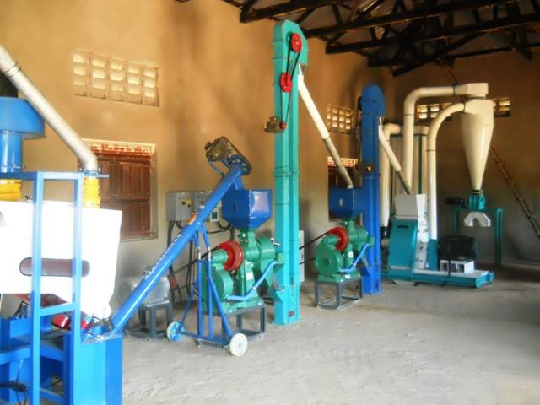
Improved equipment
IRRI has published training manuals on rice processing, including a range of equipment and practices for husking, milling, separating and polishing.
IRRI recommends using rubber rollers rather than steel rollers in order to reduce breakage during husking. http://www.knowledgebank.irri.org/step-by-step-production/postharvest/milling
Using improved milling technologies will result in reduced breakage as compared to manual milling (using a mortar and pestle).
A new maize flour processing plant in Uganda (Photo credit: Malidra Ranga, 2015)
Mod. 1.2 Slide 135

Slide 37
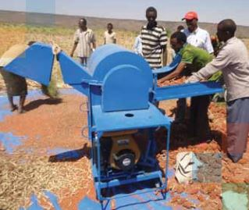
Improved milling equipment for C&P crops
Improved agro-processing equipment often requires access to electricity or diesel fuel.
A few international companies are developing solar powered equipment that can be used off-grid. The initial investment is higher in cost, but there is no cost for power during the life of the equipment.
One example is Solar Milling: (video link) https://www.youtube.com/watch?v=a10bMcyDODU
Sorghum milling in Ethiopia (Photo credit: Sasakawa Africa Association)
Mod. 1.2 Slide 36

Slide 38
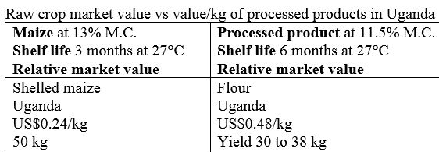
Improved processed food products
Manufacturing processed foods is a way to add value to raw crops.
Typically the processed products will sell for much higher prices than do the raw materials, and if packaged properly will have a much longer shelf life.
Mod. 1.2 Slide 37
Notes:
Sources: MAIZE: Post-harvest Operations Manual; http://www.bettagrains.com; Market Atlas Forum 2014.

Slide 39
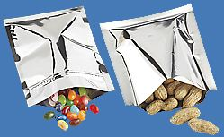
Improved packaging materials
Storage containers that can be sealed and protect the dried products from light, water, insects and rodents will greatly increase their storage life.
Metal foil packages are low cost and can protect dried C&P crops and other food products for up to one year.
Mod. 1.2 Slide 38

Slide 40
Improved containers for storage of dried C&P products
Plastic buckets can be cleaned and reused many times.
Typically, the plastic lids will break after a few uses. A new type of lid for plastic buckets of several sizes, known as a gamma-seal, can be permanently attached to a bucket, and then the center portion can be screwed on and off whenever needed without damaging the container or the lid.
Mod. 1.2 Slide 39

Slide 41
Sanitation practices
Regular sweeping of the floors is a required practice for buildings used for handling food grains and processed foods.
The prompt removal of spillage prevents insect populations developing in cracks and crevices from where they can infest the foods.
Mod. 1.2 Slide 40

Slide 42
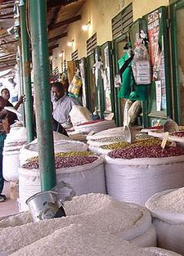
Reducing postharvest losses during (5) wholesale and retail marketing
Inventory management
Sanitation practices
Strong packages and containers
Cereals and pulses for sale in Kigali, Rwanda (Photo credit: Dan McLean)
Mod. 1.2 Slide 41

Slide 43
For more information
APHLIS and Hodges & Stathers (2012) provide a detailed illustrated guide to reducing postharvest losses for C&P crops via http://www.erails.net/FARA/aphlis/aphlis/practical-tips-for-reducing-losses/
Mod. 1.2 Slide 42

Slide 44
Working with and training 5 target groups
Working with and training these 5 target groups of beneficiaries on reducing postharvest losses
(1) small-holder farmers
(2) village and community storage operators
(3) micro, small and medium enterprises
(4) small stores
(5) market and street vendors (excluding supermarkets)
Any food loss reduction solutions promoted need to be available, cost effective and accessible in the intervention areas.
There must be support for changes in practices or adoption of new technologies, via the existence of suppliers, manufacturers/fabricants, distributors and repair services.
Mod. 1.2 Slide 43

Slide 45
Improved postharvest handling practices for (1) small-holder farmers
Smallholder farmers of C&P crops can reduce postharvest losses by focusing on a few key practices.
Maturity and harvest indices
On-farm practices (harvesting, threshing, cleaning, drying, storage)
Market access
For further information on technical practices, visit the Postharvest Compendium (INPhO) and refer to Manual 1.
Mod. 1.2 Slide 44
Notes:
Postharvest Compendium (INPhO)
http://www.fao.org/in-action/inpho/crop-compendium/cereals-grains/en/
http://www.fao.org/in-action/inpho/crop-compendium/legumes/en/
ftp://ftp.fao.org/docrep/fao/012/i0959e/i0959e00.pdf
http://documents.wfp.org/stellent/groups/public/documents/reports/wfp250916.pdf

Slide 46
Market access
Statistically, 50% of smallholders will not be able to link to a commercial market.
Therefore, it is important to keep in mind that the challenge is not merely of creating linkages to markets, but also of adequately assessing smallholder conditions, including their market options and methods of optimizing their market performance—all while ensuring that that these options are manageable for the smallholders (Ferris et al 2014).
Mod. 1.2 Slide 45
Notes:
For more information:
FAO 2015. Inclusive Business Models: Guidelines for improving linkages between producer groups and buyers of agricultural produce. http://www.fao.org/3/a-i5068e.pdf

Slide 47
Learning by doing
Examples of results demonstrations for food loss reduction for C&P crops
Drying methods: compare the drying rate and cleanliness of cereals being dried directly on the ground/soil versus spread out on a clean tarpaulin
Drying methods: compare grain quality using traditional drying practices versus a low temperature, heat assisted “bulk-in-bin” drying system
Storage technologies: compare storage life and quality of a small volume of dried pulses stored in a woven sack versus stored in a sealed plastic container such as a used oil jug or a bucket with a tight fitting lid.
Processing methods, demonstrate the yield of maize milled to flour using 3 methods: a traditional village scale stone mill versus a well maintained, mechanical mill operated at a fast speed and operated at a slower speed.
Mod. 1.2 Slide 46

Slide 48
Improved postharvest handling practices for (2) village and community storage operators
Improved storage structures
Hermetic storage
Improved storage management practices
Temperature and relative humidity (RH) management
Postharvest training for storage operators typically focuses upon introducing the key features of improved storage structures (for adequate protection from weather and pests), and on improved storage management (sanitation, inventory management, temperature and RH).
Storage operators are in business to make money, so they will be interested in the costs and benefits of any recommended practice or technology.
Mod. 1.2 Slide 47

Slide 49
Improved postharvest handling practices for (3) micro, small and medium enterprises
Commercial drying
Milling
Processing facilities for making flour, grits, etc.
Improved packaging
Micro, small and medium scale enterprises are in business to make money, so they will be interested in the costs and benefits of any recommended practice or technology.
The volume of crops that requires handling or processing will often determine which technologies make the most sense economically. There are sometimes tradeoffs to be made between fast/highest quality and cheap/highest quality, and decisions to make regarding labor for manual practices versus capital costs for machinery.
Mod. 1.2 Slide 48

Slide 50
Improved postharvest handling practices for (4) small stores and for (5) market and street vendors
Sanitation
Packaging and displays
Temporary storage
Food stores and food vendors are in business to make money, so they will be interested in the costs and benefits of any recommended practice or technology.
Mod. 1.2 Slide 49

Slide 51
Improved practices and technologies to reduce postharvest losses for key C&P crops
The following 6 slides will provide details for:
Maize
Sorghum
Millet
Rice
Cowpeas
Beans
Mod. 1.2 Slide 50

Slide 52
Improved postharvest handling, storage and marketing of Maize
Harvest index: The period between planting and harvesting for maize depends upon the variety. Generally this is 7 to 8 weeks after flowering; kernel with 35 – 40% moisture.
On-farm handling: Dry cobs in ventilated maize crib or on cement pads or tarpaulins to 13% moisture. Shell manually or via mechanical aids.
On-farm storage: Store in ventilated maize crib, or in hermetic bags, tanks or silos.
Long term commercial storage: Store maize in shaded, cool, dry conditions, using proper sanitation and pest management practices.
For more details, please refer to Manual 1
Mod. 1.2 Slide 51

Slide 53
Improved postharvest handling, storage and marketing of Sorghum
Harvest index: The optimum harvest moisture, about 20%, minimizes harvest losses, cracked grains and drying expense.
Harvesting: Cut and collect only the grain heads.
On-farm handling: Dry grain on cement pads or tarpaulins to 11% moisture, thresh and clean manually or via mechanical aids.
On-farm storage: Store in hermetic bags, tanks or silos.
Long term commercial storage: Store sorghum in shaded, cool, dry conditions, using proper sanitation and pest management practices.
For further details, please refer to Manual 1.
Mod. 1.2 Slide 52

Slide 54
Improved postharvest handling, storage and marketing of Millet
Harvest index: Begin harvesting when seed moisture content drops below 15%.
Harvesting: Cut and collect the seed heads.
On-farm handling: Dry grain on cement pads or tarpaulins to 8% moisture, thresh and clean manually or via mechanical aids. Heat assisted drying is typically required to reach 8 to 10% moisture in order to prevent storage molds. Bulk bins should be lined with fine-mesh screens and warm air should be blown up through the grain (stacked no deeper than one meter).
On-farm storage: Store in hermetic bags, tanks or silos.
Long term commercial storage: Store millet in shaded, cool, dry conditions, using proper sanitation and pest management practices.
For further details, please refer to Manual 1.
Mod. 1.2 Slide 1

Slide 55
Improved postharvest handling, storage and marketing of Rice
Harvest index: Grain moisture content ideally is between 20 and 25% (wet basis). Grains should be firm but not brittle when squeezed between the teeth, and 80−85% of the grains have turned yellow-colored (like dried straw).
Harvesting: Harvesting should be done when there is minimal surface moisture (e.g. from previous rainfall or early morning dew). Full stalks can be cut, bundled and collected if handled carefully to avoid shattering. Alternatively grains can be cut from the stalks and collected manually or via mechanical aids (small combine harvesting machines).
On-farm handling: Dry grain on cement pads or tarpaulins to 18-20% moisture, thresh and clean manually or via mechanical aids
On-farm storage: Store rice in hermetic bags, tanks or silos. Stored rice should be 14% moisture content or lower.
Long term commercial storage: Store rice in shaded, cool, dry conditions, using proper sanitation and pest management practices.
Mod. 1.2 Slide 54
Notes:
For more information: Rice Postharvest Operations via INPhO Postharvest Compendium http://www.fao.org/3/a-ax442e.pdf

Slide 56
Improved postharvest handling, storage and marketing of Cowpeas
Harvest index: At maturity, leaves will dry down but may not drop off completely. Cowpeas should be harvested when seed moisture content is 14 to 18%, depending on the consumer’s requirement.
Harvesting: Manual or combine harvest. Dry pods can remain about a week awaiting harvesting without spoilage. However, to avoid field weathering or shattering, dry pods should not be left in the field longer than 2 weeks after full pod maturity.
On-farm handling: Dry cowpeas on cement pads or tarpaulins to 12% moisture, thresh and clean manually or via mechanical aids. Sort out any cracked or brokens.
On-farm storage: Store in hermetic bags, tanks or silos. Only short term storage is possible at around 12 % moisture, with much lower (8 to 9%) moisture recommended for long-term storage.
Long term commercial storage: Store cowpeas in shaded, cool, dry conditions, using proper sanitation and pest management practices.
Mod. 1.2 Slide 55

Slide 57
Improved postharvest handling, storage and marketing of Dry beans
Harvest index: Maturity is indicated by well filled pods and less than 15% moisture content.
Harvesting: In developing countries, harvesting is mostly manual. Determinate plants are pulled up and placed in rows or piles, very early in the morning to avoid pods opening. Indeterminate plants have to be harvested pod by pod as they mature and climb upwards. Bean pods are collected in baskets or buckets.
On-farm handling: Dry beans on cement pads or tarpaulins to 13% moisture, thresh and clean manually or via mechanical aids. Drying to less than 13% moisture will increase the likelihood of cracking. Sort out any cracked or broken beans.
On-farm storage: Store in hermetic bags, tanks or silos.
Long term commercial storage: Store dry beans in shaded, cool, dry conditions, using proper sanitation and pest management practices.
Mod. 1.2 Slide 56

Slide 58
Costs and benefits
It is simple to calculate the local costs and expected benefits for any new or improved practice or technology by estimating relative changes in comparison to the current practice or technology.
Only the differences are calculated, for a simplified, partial economic analysis, making it easy to do as a training exercise with farmers or traders.
Using 100kg or 1000kg of produce to make the calculations allows the user to perform easy math, then multiply the results by whatever volume will actually be harvested/handled and sold.
POSTHARVEST COSTS & BENEFITS WORKSHEET: | Current /traditional practice | New /improved practice
Describe:
COSTS
Relative costs
EXPECTED BENEFITS
% postharvest losses
Amount for sale
Value/kg
Total market value
Total market value (BENEFITS) minus relative costs
Mod. 1.2 Slide 57

Slide 59
Cost/Benefit examples
Example #1
Cereals: Improved maize crib storage
Maize stored in ventilated cribs, and protected from rodents and insects in Uganda experience much lower losses and can be sold at higher market prices.
Example #2 Pulses: Storage of cowpeas in hermetically sealed PICS bags
Cowpeas dried to the proper low moisture (12%) and stored in PICS bags for 6 months will have less than 1% postharvest losses.
Mod. 1.2 Slide 58

Slide 60
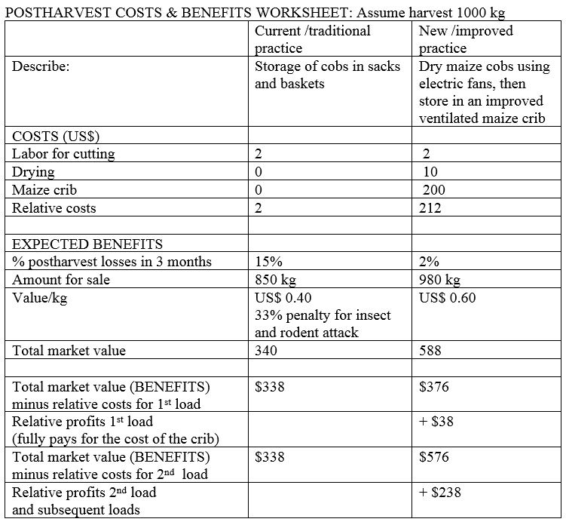
Calculating Costs and Benefits Example 1: Improved maize crib storage
Mod. 1.2 Slide 59

Slide 61
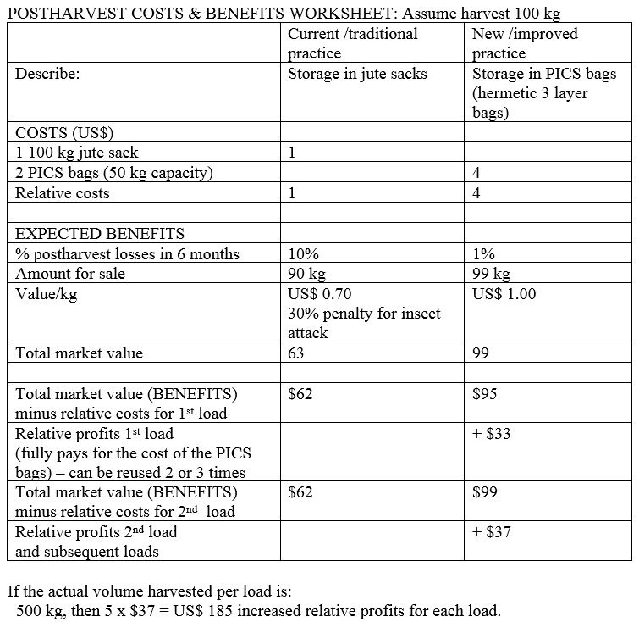
Cost/Benefit example 2: Dried Cowpeas storage in PICS bags
Mod. 1.2 Slide 60

Slide 62
Priority training needs
Topics that need attention in order to solve postharvest and storage problems for a variety of cereals and pulses
Basic postharvest handling practices
Temperature management and relative humidity control in storage
Postharvest pest and disease management in storage
Mod. 1.2 Slide 61

Slide 63
Advocacy issues
Problems that require attention in order to reduce food losses for a variety of cereals and pulses
Improving infrastructure (roads, power, water)
Promoting the development of an on-farm, low-cost drying process that is able to bring down the moisture content of grains to 13% as fast as possible
Investing in postharvest facilities (storage structures)
Investing in agro-processing (SMEs) for cereals and pulses
Improved marketing (facilities, farmer/trader organizations, cooperatives)
Providing incentives for using improved postharvest practices and investments
Mod. 1.2 Slide 62

Slide 64
End of Module 1.2
This concludes Module 1.2
Reducing Postharvest Losses in Sub-Saharan Africa: Cereals and Pulses
Manual 1 contains a full reference list.
Mod. 1.2 Slide 63

