Slide 1
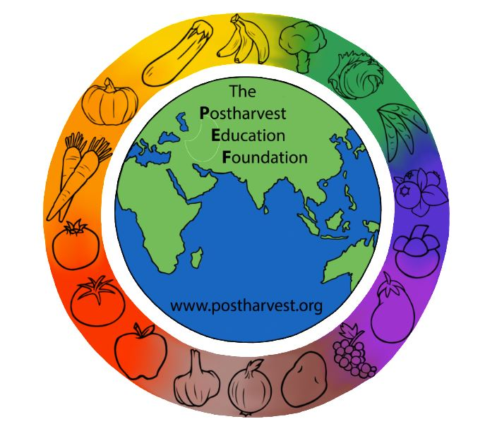
Reducing Postharvest Losses in Sub-Saharan Africa: Training for extension workers, technical specialists and practitioners
The Postharvest Education Foundation
2023
Slide set for Manual 1. ISBN: 978-1-62027-026-4
Module 1.3

Slide 2
Module 1.3 Reducing Postharvest Losses in SSA: Roots and Tubers
Learning objectives for practitioners:
To gain an understanding of the many options available for addressing the causes of postharvest losses identified in food loss assessments for root and tuber crops.
To be introduced to key postharvest technologies, improved handling practices and management skills that can help the 5 beneficiary groups reduce postharvest food losses for roots and tuber crops
To be able to use a simple worksheet to calculate the local costs and expected benefits for any new or improved practice or technology by estimating relative changes in comparison to the current practice or technology
To be made aware of topics or areas of training/extension and advocacy that are needed to solve postharvest problems for a roots and tuber crops
Mod. 1.3 Slide 1

Slide 3
Key root and tuber (R&T) crops in SSA
Cassava
Sweetpotatoes
Yams
Cocoyams
These crops are underground plant storage organs, mostly composed of carbohydrates, and are produced in tropical or sub-tropical conditions. They have low respiration rates and are generally considered to be less perishable than other types of fresh produce.
Mod. 1.3 Slide 2

Slide 4
The 5 segments of roots and tuber crops supply chain
This module covers 5 segments of roots and tuber crops supply chain
(1) harvesting & postharvest handling (on-farm)
(2) storage
(3) transportation
(4) agro-processing
(5) wholesale and retail
The majority of the total of 67.7 million tonnes per year of food losses for R&T crops in SSA occur during
production/harvesting (26.4m tonnes)
postharvest handling and storage (29.3m tonnes) and
processing/packaging (7.4m tonnes). Source: Gustavsson et al., 2013.
Mod. 1.3 Slide 3

Slide 5
Reducing postharvest losses during (1) harvesting & postharvest handling on farm
These six practices are very important for reducing losses of R&T crops for reducing postharvest losses during harvesting & postharvest handling on the farm.
Maturity / age of plant
Harvesting/digging as gently as possible
Sorting to remove damaged or decayed produce
Curing before postharvest handling, packing, storage or marketing
Use of improved containers to reduce damage
Use of shade to provide a source of natural cooling
Mod. 1.3 Slide 4

Slide 6
Maturity, quality and harvesting
Maturity/age of plant
In the field, the mature crop is generally recognized by the end of vegetative growth and yellowing of the leaves.
For cassava, the food quality of roots (the starch content), increases with time up to an optimal period of 12 to 15 months after planting, after which there is a loss of quality, mainly due to increased lignification (which makes the texture stringy).
Harvesting/digging
It is easy to damage R&T crops when digging, especially when using large hand tools or mechanical harvesters (lifters).
The produce can be cut or broken, leaving wounds that provide easy access for disease organisms.
Mod. 1.3 Slide 5

Slide 7
Sorting to remove damaged or decayed produce
Pre-sorting in the field immediately after harvest is used to remove any defective produce from the harvested lot, especially decayed or insect infested R&T.
If these units are not removed before packing, transport and/or storage, the decay pathogens or insects pests can spread to the rest of the load.
Buyers may be willing to pay more if they are provided regularly with higher quality produce at the farm gate.
Mod. 1.3 Slide 6

Slide 8
Curing R&T crops before postharvest handling, packing, storage or marketing
Curing heals any harvest wounds and protects these crops from water loss. The process will be more described fully in the next Slide.
Curing is accomplished by holding the produce at high temperatures and high relative humidity for several days while harvesting wounds heal and a new, protective layer of cells form.
Cooler temperatures will slow the curing process.
While curing is associated with a small amount of weight loss, the long extension of storage life makes the practice economically worthwhile.
Storage life is longer with good quality and appearance (less sprouting, nicely healed wounds, less decay, firm peel). Well cured sweet potatoes can be stored for 7 months at 15 °C.
Mod. 1.3 Slide 7

Slide 9
Recommended curing practices for R&T crops
Cured R&T crops experience less water loss and lower weight losses during storage and marketing.
Booth (1974) reported that loss of weight in sweetpotato after 113 days of storage was 17% in the cured samples and 42% in uncured roots.
Sweetpotatoes will lose about 3% of their weight during curing, then water losses will be reduced to about one half of that experienced by uncured roots during long term storage.
Mod. 1.3 Slide 8

Slide 10
Curing on the farm
Successful, rapid curing requires high temperature and high relative humidity, and this type of natural covering will trap self-generated heat and moisture.
The stack should be left for about four days (yams) or five days (cassava, sweetpotatoes or cocoyams) and then checked to feel the peel of the produce.
If the peel is firmly attached and does not slip when pressed sideways using light finger pressure, the curing process is complete (Kitinoja and Kader, 2015).
Cut-away view of a pile of yams being cured in the field (covered with straw and canvas cloth, under shade). Source: Wilson (no date).
Mod. 1.3 Slide 9

Slide 11
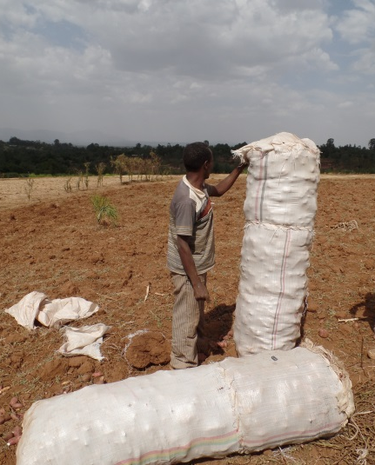
Improved containers
Polypropylene sacks of sweetpotato roots weighing more than 100 kg is the common practice in eastern Africa, and results in significant skinning and bruising injuries (Ndunguru et al 2000).
Postharvest loss assessments have documented 85% peel damage in Tanzania (Tomlins et al 2002), and 100% damaged roots in Ethiopia (Parmar 2017) after transport to market.
Smaller sized sacks can reduce damage and losses (see slide notes for examples).
100kg sack of sweetpotatoes in Ethiopia (Photo credit Aditya Parmar)
Mod. 1.3 Slide 10
Notes:
Tomlins et al. 2002 pointed out that using 20kg fiberboard cartons can significantly reduce the skinning and mechanical damages during loading, unloading and transportation. Packaging roots and tubers in full telescopic fiberboard cartons with paper wrapping or excelsior reduces bruising and enables large quantity of tuber to be transported over long distances. R&T crops can be contained in loose packs, or units of 10-11 kg or 23-25 kg (McGregor, 1987).
Large sized reusable plastic crates (holding 30 to 40 kg) are another improved container that is more suitable for local handling, storing, transporting and marketing of root and tuber crops. The use of plastic crates can reduce physical damage to less than 5%.
Ventilated plastic crates must be utilized as part of a carefully planned postharvest handling system, such as that organized and managed by a marketing cooperative, food processing buyer, supermarket buyer, farmers association or exporter, since the crates must be transported to the packinghouse or end buyer, emptied, washed and returned to the farmer’s fields in between uses.

Slide 12
Use of shade
Exposure to the sun should be avoided as much as possible during and after harvest, since roots and tubers left out in the sun will gain heat and may become sun-burned and dehydrated.
Produce exposed to sunlight can soon become 4 to 6 °C warmer than air temperature.
Field containers should be placed in the shade, under a tree, or loosely covered (e.g. with light colored heavy cloth, leafy plant materials, loose straw, a woven matt or an inverted empty container) if delays are expected in removing filled containers from the field.
Mod. 1.3 Slide 11

Slide 13
Reducing postharvest losses during (2) storage
There are five important factors/practices that can help to reduce postharvest losses of R&T crops during storage
Improved storage structures on farm
Curing before storage
Waxing
Commercial storage using evaporative cooling technologies
Pest control
Mod. 1.3 Slide 12

Slide 14
Improved storage structures on farm
Traditional R&T storage on the farm includes 1) leaving the crop in the soil (unharvested) until needed, 2) underground storage structures (e.g. in loose piles of ashes and soil, pits lined with straw or field clamps) and 3) above ground ventilated structures (such as the yam barn).
Leaving R&T in the ground until required is the simplest storage technique practiced by rural small-scale farmers, but this type of storage prevents the use of the farmland for growing the next crop.
Sweetpotatoes are susceptible to attack by weevils if left in the ground after full maturity.
Mod. 1.3 Slide 13

Slide 15
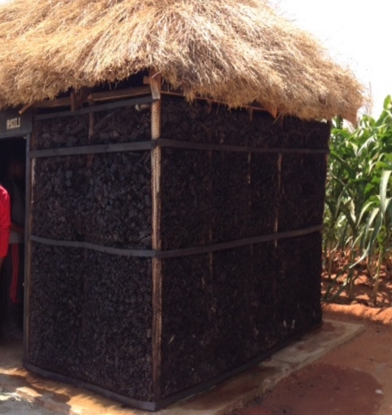
Examples of improved on-farm structures
Improved on farm storage structures can double the storage life of R&T crops, mainly by lowering temperature and providing better protection from rodents and insect pests.
Ventilated storage, cooled naturally via evaporative cooling systems
Walk-in storage room, with cement floor, pallets, shelving or racks
Low cost, made locally from indigenous materials (wooden frame, charcoal pieces) and wire mesh (chicken wire mesh or similar type screening materials)
Walk-in charcoal cool room in East Africa (mesh walls filled with pieces of charcoal). The storage room walls are kept wet and natural evaporation acts to carry heat away from the chamber and the produce stored inside.
(Photo credit: Bertha Mjawa)
Mod. 1.3 Slide 14
Notes:
Plans for construction of a charcoal cool room can be found on this website: http://www.postharvest.org/images/CharcoalcoolstoragePNACQ751.pdf

Slide 16
Curing before storage of R&T crops
If you are storing R&T crops in a modern cool storage (at 14-16°C) and selling by weight, curing can reduce weight losses from the typical level of about 22% (for uncured) to 10% losses during 6 months of storage time.
Shed curing: if the weather is rainy or it is too hot in the field, R&T crops can be cured under shade. A tent or three walled open shed is a good option, since these are low cost and allow for plenty of air circulation.
Heat added curing: if the weather is cold and damp, then added heat may be needed to accomplish the curing process. Heat can be added via a propane burner, electricity or even via a small wood or charcoal fire. The warmed air can be moved through the pile of curing crops using a small fan.
Curing conditions for root and tuber crops are WARM and MOIST
Mod. 1.3 Slide 15

Slide 17
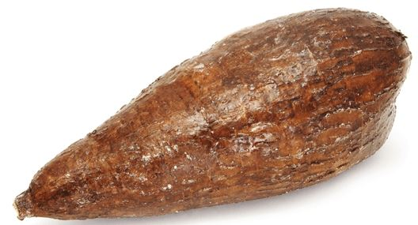
Waxing R&T crops before storage and marketing
Paraffin wax can be applied to cassava roots, and will reduce water loss by 50% and extend shelf life from less than 2 days to about 10 days (Baldwin et al 2012).
The heated wax is generally applied as a spray or a dip.
The roots must be clean and completely dry, or the wax will flake off after drying (Grant and Burns 1994).
Paraffin wax has been successfully used since the 1940s, but newer, water based carnauba waxes can be used with the same positive effects (Sargent et al 1995).
Waxed cassava root in Ghana (Photo credit: Lisa Kitinoja)
Mod. 1.3 Slide 16

Slide 18
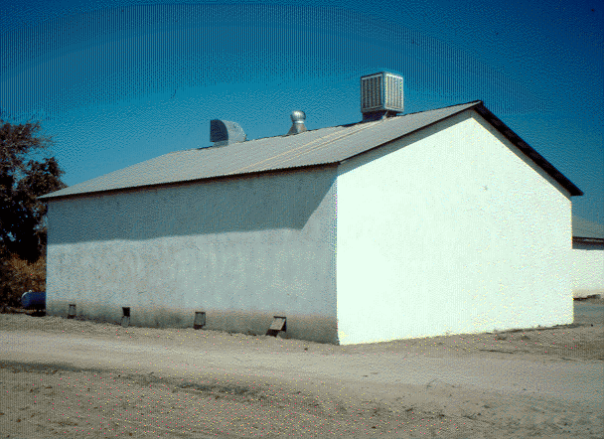
Commercial storage structures and evaporative cooling technologies
Evaporative cool storage structures (e.g. use of electric powered “swamp coolers”, or passively cooled charcoal cool rooms) are cost effective and practical for longer term storage of the R&T crops that have a good storage potential at 12 to 15°C.
Photo credit: J F Thompson
Mod. 1.3 Slide 17
Notes:
Please refer to Manual 5b for more details and general maintenance tips.

Slide 19
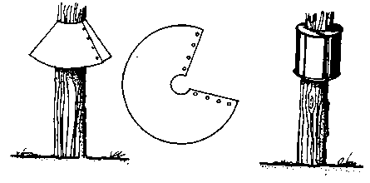
Pest control
Damage from harvesting wounds and insect pests provide the entry points for postharvest decay organisms, so the best defense against decay is to properly cure R&T crops before storage.
If possible a store should be raised to 1m above ground height, and rodent guards should be placed on the legs to prevent rodents from being able to access the stored commodity.
It is quite difficult to keep insect pests out of storage structures used for R&T crops, so it is common to use traps (for rodents and insects), pesticides and/or fumigation practices. Curing should precede any fumigation treatment against insects (Afek and Wiseblum, 1995).
Rat guards made from metal sheeting or empty cans. Source: FAO. 1985.
Mod. 1.3 Slide 18

Slide 20
Reducing postharvest losses during (3) transportation
Relatively low losses are experienced for R&T crops in SSA during transportation.
Damage from rough handling and poor quality packages cause bruising and scuffing that can lead to PL that will be noticed later on in the food supply chain.
Loading/unloading
Stacking, ventilation
Covering open loads
Mod. 1.3 Slide 19

Slide 21
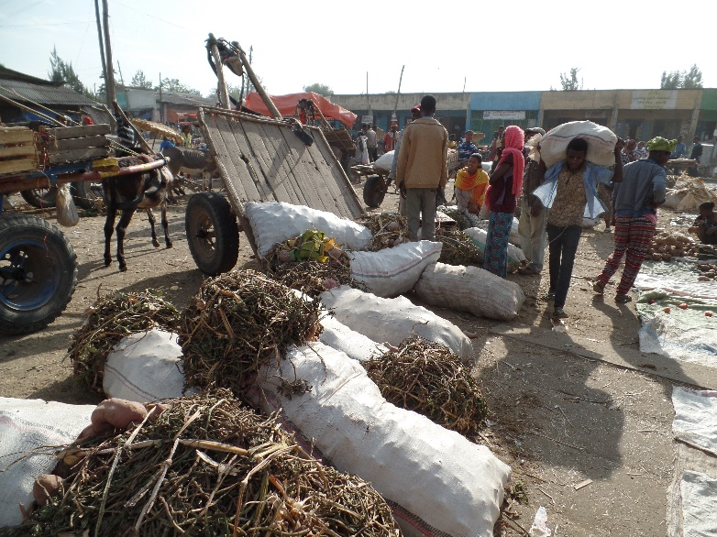
Loading/unloading practices
Gentle handling can help to reduce postharvest losses during loading and unloading of R&T crops.
Containers that are too large will tend to be dropped by workers.
Loading and unloading sacks of sweetpotatoes in Ethiopia. (Photo credit: Aditya Parmar)
Mod. 1.3 Slide 20

Slide 22
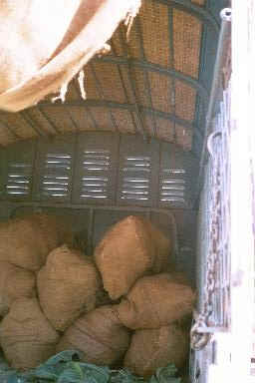
Stacking, ventilation
For crops in packages, the stacks should not be too high, and people should not walk on the sacks or on the top of the load.
For bulk loads, adding some cushioning on the bottom and sides of the vehicle can reduce damages during transport, and making sure there is some space left for ventilation under the load and along the sides and top can help reduce postharvest losses.
A heavily packed, overloaded truck will allow the R&T crops to heat up during transport. Also, the risk of damage due to compression is high.
Vehicle with front vents and a tall cover.
Photo credit: Lisa Kitinoja
Mod. 1.3 Slide 21

Slide 23
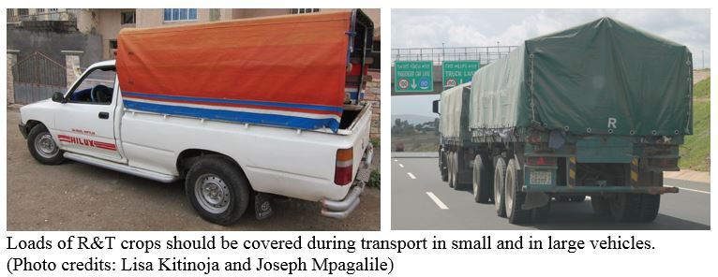
Covering open loads
Protecting the crops from the sun, wind and rain during transport will help to reduce contamination and reduce postharvest loses of R&T crops
Mod. 1.3 Slide 22

Slide 24
Reducing postharvest losses during (4) agro-processing
Agro-processing of R&T crops may include:
Use of mechanical peelers, chippers, graters
Improved drying practices
Improved packages and containers
Containers for dried R&T products
Sanitation
Mod. 1.3 Slide 23

Slide 25
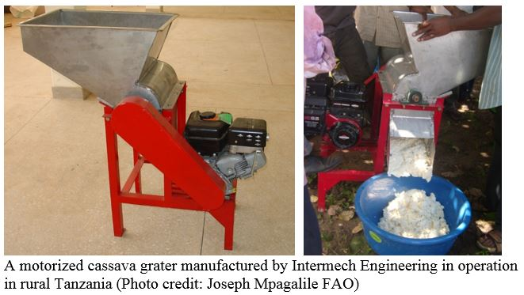
Use of mechanical peelers, chippers, graters
Processing of cassava into dried products (gari, chips, high quality cassava flour): Use of a package of improved mechanical devices developed by IITA for peeling, grating or grinding, chipping, dewatering, sifting and frying, along with proper training, can reduce processing losses from 22% to 10%.
Mod. 1.3 Slide 24

Slide 26
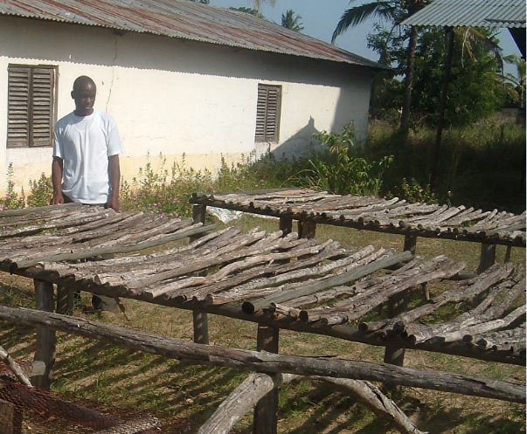
Improved drying practices for cassava: solar drying or heating in an oven
Reducing moisture to a point where all physiological reactions and microbial growth are inhibited can tremendously increase the short shelf-life of cassava roots.
In cassava, this point is at 14% moisture content.
Most cassava food products are dried to 8 to 12% moisture for long term storage (Opara 2003), which may require heating in an oven.
Raising the drying surface will improve quality and shorten the time needed for solar drying.
Raised mesh tables for drying cassava in Tanzania
(Photo credit: Joseph Mpagalile, FAO).
Mod. 1.3 Slide 25

Slide 27
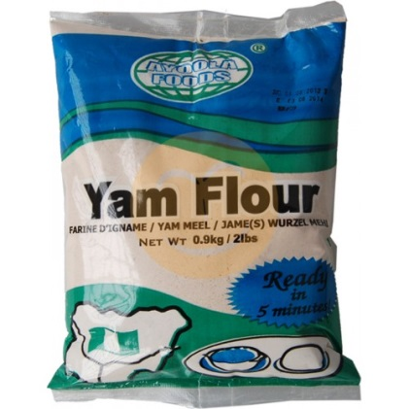
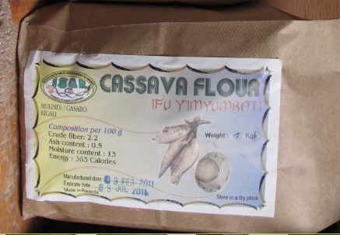
Improved packages and containers
Storage containers that can be sealed and protect the dried products from light, water, insects and rodents will greatly increase their storage life.
Containers for dried R&T products: Metal foil packages are low cost and can protect dried R&T and processed food products against light, moisture and the damage they can cause (rancidity and discoloration) for up to one year
Heat sealed, heavyweight plastic pouches are used for packaging flours made from R&T crops in Nigeria, while heavyweight paper packages are used in Rwanda (Photo credits: Lisa Kitinoja and Dan McLean)
Mod. 1.3 Slide 26
Notes:
Metal foil packages are available in zip lock or heat sealed versions (Source: www.uline.com).

Slide 28
Reusable containers
Plastic buckets can be cleaned and reused many times for storage of dried R&T crop food products.
Typically, the plastic lids will break after a few uses.
A new type of lid for plastic buckets of several sizes, known as a gamma-seal, can be permanently attached to a bucket, and then the center portion can be screwed on and off whenever needed without damaging the container or the lid.
Mod. 1.3 Slide 27

Slide 29
Sanitation practices
Regular sweeping of the floors is a required practice for buildings used for handling fresh and processed foods.
The prompt removal of spillage prevents insect populations developing in cracks and crevices from where they can infest the foods.
Mod. 1.3 Slide 28

Slide 30
Reducing postharvest losses during (5) wholesale and retail marketing
Gentle handling
Use of shade
Sanitation
Mod. 1.3 Slide 29

Slide 31
Gentle handling
Large sacks of R&T are often dropped while being unloaded, and are sometimes treated like furniture.
It is not uncommon to see people sitting on sacks while they rest in the marketplace in SSA.
An extreme example comes from Addis Ababa market, where a buyer was photographed while doing his paperwork as he sits on a chair which has been set on top of a stack of sacks of sweetpotatoes. (Photo credit: Aditya Parmar)
Mod. 1.3 Slide 30

Slide 32
Use of shade
Undamaged sweetpotatoes in the marketplace in Ethiopia, kept for 7 days in the shade, lost about 15% of their weight, while those without shade lost more than 30% of their weight (Parmar et al 2016).
Partial shade in Awassa main market, Ethiopia. (Photo credit Aditya Parmar).
Mod. 1.3 Slide 31

Slide 33
How to work with and train 5 target groups
Details on how to work with and train the 5 target groups/ beneficiaries to reduce postharvest losses of R&T crops
(1) small-holder farmers
(2) village and community storage operators
(3) micro, small and medium enterprises
(4) small stores
(5) market and street vendors (excluding supermarkets)
The majority of postharvest losses for R&T crops in SSA will be experienced by small-holder farmers, traders and village/community storage operators. Relatively low levels of postharvest losses occur during transport and marketing.
Mod. 1.3 Slide 32

Slide 34
Improved postharvest handling practices for (1) small-holder farmers
Training on these four topics will assist smallholder farmers to harvest R&T crops of good quality, and to protect the crops from the most common causes of damage and losses.
Maturity/age of plant
Harvesting/digging
Curing on the farm
Market access
Key Resource: Postharvest Compendium (INPhO)
http://www.fao.org/in-action/inpho/crop-compendium/roots-tubers/en/
Mod. 1.3 Slide 33

Slide 35
Market access
Smallholder farmers often have limited knowledge regarding market prices and consumer demand or preferences.
Advocating and promoting the formation of farmer’s groups as formal or informal associations, cooperatives or small businesses is one approach to improving access to markets (WFLO 2010, Ferris et al, 2014).
Promoting a market-driven approach not only helps to improve access but ensures there is sufficient market demand for the products.
A market-oriented approach can demonstrate economic and technical feasibility, hence a higher adoption rate and improved sustainability.
Mod. 1.3 Slide 34
Notes:
For more information:
FAO 2015. Inclusive Business Models: Guidelines for improving linkages between producer groups and buyers of agricultural produce. http://www.fao.org/3/a-i5068e.pdf

Slide 36
Learning by Doing
Examples of results demonstrations for food loss reduction for R&T crops.
Curing R&T crops: compare the quality and rate of weight loss for sweetpotatoes that have been cured in the field prior to storage versus those stored without curing.
Waxing R&T crops: compare the rate of weight loss at ambient temperature for 3 days for a sample of root crops that are waxed versus a sample that has not been waxed.
Drying methods: compare the drying rate and cleanliness of R&T crops being dried directly on the ground/soil versus spread out on a clean tarpaulin
Storage technologies: compare storage life and quality of a small volume of dried cassava chips stored in a woven sack versus stored in a sealed plastic container such as a used oil jug or a bucket with a tight fitting lid.
Processing methods, demonstrate the yield of cassava milled to flour using 3 methods: a traditional village scale stone mill versus a well maintained, mechanical mill operated at a fast speed and operated at a slower speed.
Mod. 1.3 Slide 35

Slide 37
Improved postharvest handling practices for (2) village and community storage operators
Postharvest training for storage operators typically focuses upon introducing the key features of improved storage structures (for adequate protection from weather and pests), and on improved storage management (loading or stacking practices, sanitation, inventory management, temperature and RH).
Curing before storage of fresh R&T crops
Loading and stacking the stored R&T crops
Insect control
Rat / rodent control
Containers for dried R&T products
Temperature and RH management
Improved storage management
Mod. 1.3 Slide 36

Slide 38
Preparations for storage
Curing before storage: If you are storing R&T crops in a modern cool storage (at 14-16°C) and selling by weight, curing can reduce weight losses from the typical level of about 22% (for uncured) to 10% losses during 6 months of storage time.
Containers for dried R&T products
Storage containers that can be sealed and protect the dried products from light, water, insects and rodents will greatly increase their storage life. Plastic buckets can be cleaned and reused many times.
Mod. 1.3 Slide 37

Slide 39
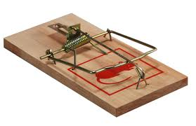
Pest control
Insect control
IITA has determined that the main insect feeding on dry cassava chips in Benin Republic was Dinoderus sp. (Saizonou, 1996).
Rat / rodent control
Traps and rat guards are commonly used to provide low cost pest control.
Generic wooden rat trap
Mod. 1.3 Slide 38

Slide 40
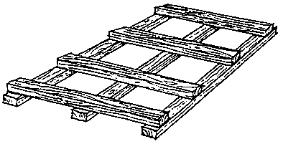
Improved storage management
Pallets, Inspections, Sanitation/food safety protocols
Placing materials on the floor beneath sacks or cartons of produce prevents dampness from reaching produce suited to dry conditions in storage. This helps to reduce the chance of fungal infection, while also improving ventilation and/or sanitation in the storeroom.
Wooden pallet. (Source: FAO. 1985)
Mod. 1.2 Slide 39

Slide 41
Improved postharvest handling practices for (3) micro, small and medium enterprises
Peeling, trimming
Drying and Food safety
The volume of crops that requires handling or processing will often determine which technologies make the most sense economically.
There are sometimes tradeoffs to be made between fast/highest quality and cheap/highest quality, and decisions to make regarding labor for manual practices versus capital costs for machinery.
Mod. 1.3 Slide 40

Slide 42
Peeling and trimming
Workers who peel and trim R&T crops can waste food if the practices are not done carefully.
Machine peeling may remove more of the outer layers than manual peeling. Peeling is not considered a loss if the peel is not edible, but if the practice removes edible food then it is possible to refine the process and reduce postharvest losses.
There is usually a tradeoff to be made between speed and quality
Mod. 1.3 Slide 41

Slide 43
Drying to a safe moisture level for long term storage/Food Safety
A survey of cassava chips processing areas of Benin, Ghana and Nigeria has indicated that the most common fungi were Rhizopus sp. (47.5% of total samples) and Aspergillus sp. (29.6%) (IITA, 1996) and 13 different aspergillus fungi were isolated from dried cassava chips in Cameroon (Ossono et al, 2007). These fungi grow quickly when the moisture content of cassava chips is higher than 14%.
Aflatoxins can be a problem in dried R&T crops if they are not properly dried and protected from moisture during storage and marketing.
Mod. 1.3 Slide 42

Slide 44
Aflatoxin management
A highly toxic metabolite produced by the ubiquitous Aspergillus flavus fungus is a major public health issue in Africa.
The fungus infects crops and produces the toxin in the field and in stores, then the fungus is carried from field to store.
Contamination is possible without visible signs of the fungus, and very low levels are toxic (maximum allowable levels = 20 ppb US; 10 ppb WFP; 4 ppb EU).
Mod. 1.3 Slide 43

Slide 45
Some predisposing factors for aflatoxin contamination
Some predisposing factors for aflatoxin contamination:
pre-harvest high night-time temperatures and drought stress
wet conditions at harvest and post-harvest periods
insect or bird damage
rain on the mature crop increases contamination.
associated with high humidity in the field & store, insect damage, and improper crop storage or transportation.
Source: PACA and IITA http://www.aflatoxinpartnership.org
Mod. 1.3 Slide 44

Slide 46
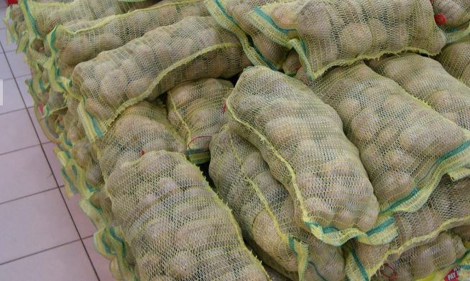
Improved postharvest handling practices for (4) small stores/food shops
Inventory management for small stores and food shops can help to reduce postharvest losses of fresh R&T crops.
A first-in/first-out system can ensure that older crops are not forgotten until they are too old and deteriorated to sell.
Net bags for R&T crops in a retail shop in Ghana (Photo credit: Adel Kader)
Mod. 1.3 Slide 45

Slide 47
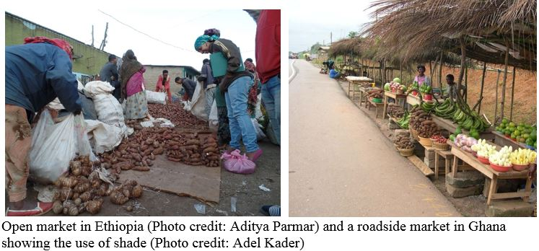
Improved postharvest handling practices for (5) market and street vendors
The most important practices for reducing postharvest losses for R&T crops in open markets are:
Use of shade
Gentle handling
Mod. 1.3 Slide 46

Slide 48
Details on how to reduce losses for these key root/tuber crops in SSA
The next 3 slides will provide details on these key crops:
Cassava
Sweetpotatoes
Yams
Cocoyams
Mod. 1.3 Slide 47

Slide 49
Improved postharvest handling, storage and processing of Cassava
Harvest index: Cassava roots can be harvested at any time of the year. Some farmers harvest as early as six months after planting while others may leave the crop to grow for 18 to 24 months. The food quality of roots (the starch content), increases with time up to an optimal period of 12 to 15 months after planting (Opara 2003).
Harvesting practices: Prune cassava plants by removing the top of the plant and leaving a short (20 cm) leafless stem 2 to 3 weeks before harvest. Gently dig around the base of the plant to free the roots from the soil. Lift the whole plant, gently, to avoid breaking the roots.
Curing: Should be practiced to heal harvesting wounds if cassava roots will be stored for any length of time after harvest, or transported for long distances. Curing requires 2 to 5 days at 30-40°C and 90-95% RH.
Long term cool storage: Cassava is not typically stored for long periods of time.
Processing: Use of improved mechanical devices can reduce processing losses from 22% to 10% (IITA 1996).
Mod. 1.3 Slide 48

Slide 50
Improved postharvest handling and storage of Sweetpotatoes
Harvest index: Sweetpotatoes are harvested when roots have reached the desirable size. Irrigation is typically stopped 2 to 3 weeks before harvest so that vines begin drying before they are removed and roots are harvested.
Harvesting practices: Dig carefully to avoid damaging the roots. Mechanical damage during harvest can become a serious problem, as injuries predispose produce to decay, increased water loss and increased respiration and ethylene production rates. All of these factors will, in turn, lead to quicker deterioration. In general, harvesting by machine will cause more damage than harvesting by hand, although root and tuber crops can be severely damaged by careless hand digging.
Curing: Curing requires 4 to 7 days at 30-32°C and 85-90% RH. CIP (2014) has reported that sweetpotatoes can be cured “in-ground” before harvesting. Pre-harvest curing consists of removing the foliage 2 to 4 days before harvesting the roots, which strengthens the skin, helping to prevent damage.
Storage: The recommended storage temperature for sweetpotatoes is 15 °C. Temperatures above 15°C (59°F) lead to more rapid sprouting and weight loss.
Mod. 1.3 Slide 49

Slide 51
Improved postharvest handling and storage of Yams and Cocoyams
Harvesting practices: Gently dig around the tuber to loosen it from the soil, lift it, and cut it from the vine. Harvesting is done by hand using sticks, spades or diggers.
Curing: Curing yams requires 1 to 4 days at 32-40 °C and 90-100% RH. Cocoyams require 3 to 5 days at 30-35 °C and 95% RH for proper curing.
Cleaning: Prior to long-term storage and marketing, yams are cleaned (without water) by scrapping off soil and other debris on the surface. This is known as “dry brushing”. The root hairs are also removed to so that the tubers have a smooth surface. Water must not be used to clean tubers before storage because of increased susceptibility to microbial infection and growth under the ambient humid storage conditions (Opara 2003).
Temporary storage (on-farm): Cool storage under evaporatively cooled conditions can extend the shelf life of cocoyams, malanga, and yams to a few weeks.
Long term cool storage: Yams can be stored for 6 to 7 months if they are kept cool (16°C) and in 70-80% RH conditions.
Mod. 1.3 Slide 50

Slide 52
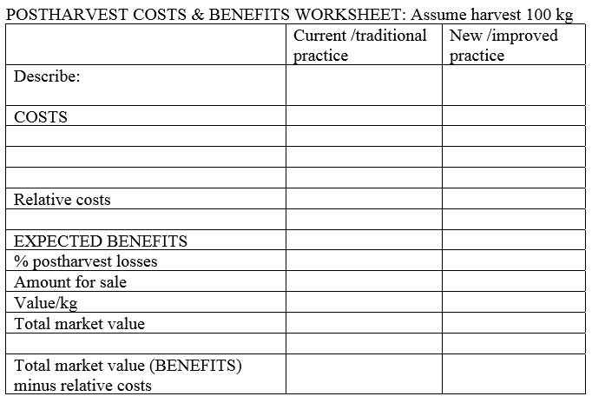
Costs and benefits
It is easy to learn how to use a simple worksheet to calculate the local costs and expected benefits for any new or improved practice or technology by estimating relative changes in comparison to the current practice or technology.
Consider only the relative differences between the two (ignore any costs that are the same).
Using 100kg or 1000kg of produce to make the calculations allows the user to perform easy math, then multiply the results by whatever volume will actually be harvested/handled and sold.
Mod. 1.3 Slide 51

Slide 53
Cost/Benefit examples
Roots: Curing sweetpotatoes before storage
Curing can reduce postharvest losses in storage from 25% to less than 10%
Tubers: Processing fresh yams using fee for service equipment, and packaging flour.
Yam flour is made from yams that have been peeled, sliced, cleaned, dried and then blended into a flour, used to make àmàlà iṣu in Nigeria.
Mod. 1.3 Slide 52

Slide 54
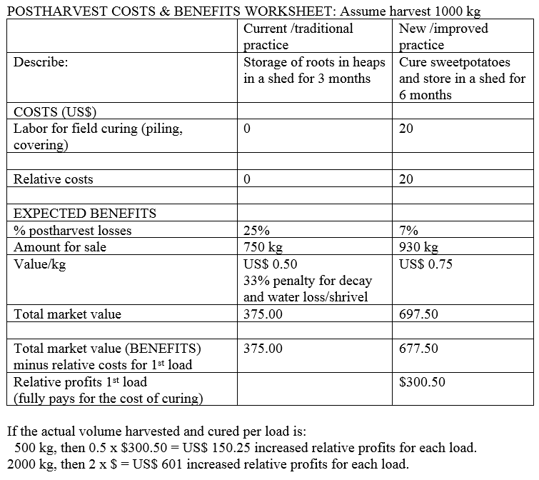
Cost/Benefit Example #1: Curing sweetpotatoes before long term storage
Mod. 1.3 Slide 53

Slide 55
Cost/Benefit Example #2: Processing yams to flour
Mod. 1.3 Slide 54

Slide 56
Priority training needs
Topics that need attention in order to solve postharvest problems for a variety of roots and tuber crops
Careful harvesting
Basic postharvest handling and curing practices
Use of improved containers to reduce postharvest damage
Temperature management and relative humidity control
Postharvest pest and disease management
Mod. 1.3 Slide 55

Slide 57
Advocacy issues
Problems that require attention in order to reduce postharvest losses for a variety of roots and tuber crops
Improving infrastructure (roads, power, water)
Investing in postharvest facilities (packinghouses, storage structures)
Investing in agro-processing (SMEs) for root and tuber crops
Improved marketing (facilities, farmer/trader organizations, cooperatives)
Providing incentives for using improved postharvest practices and investments
Farmers have been struggling with the ability to adopt the use of smaller containers. Governments have been promising to enforce some control to avoid extra-large size bags in Ethiopia, for example, but enforcement has been very poor.
Mod. 1.3 Slide 56

Slide 58
End of Module 1.3
This concludes Module 1.3
Reducing Postharvest Losses in Sub-Saharan Africa: Roots and Tuber Crops
Manual 1 contains a full reference list
Mod. 1.3 Slide 57

