Slide 1
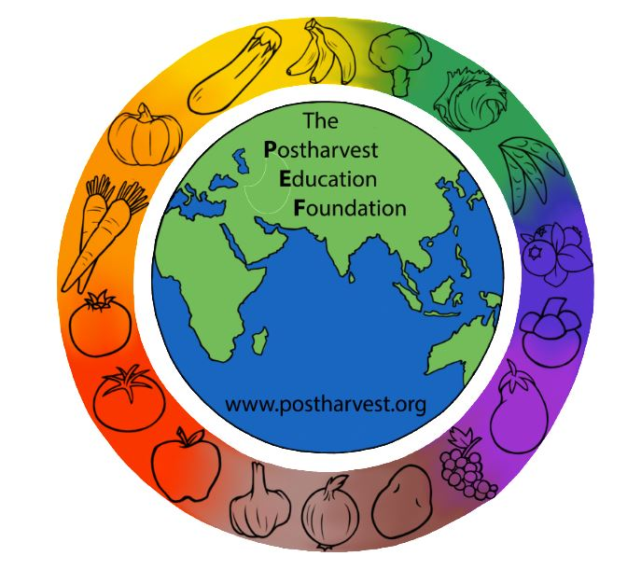
Reducing Postharvest Losses in Sub-Saharan Africa: Training for extension workers, technical specialists and practitioners
The Postharvest Education Foundation
2023
Slide set for Manual 1. ISBN: 978-1-62027-026-4
Module 1.4

Slide 2
Module 1.4 Reducing Postharvest Losses in SSA: Fruits and Vegetables
Learning objectives for practitioners:
To gain an understanding of the many options available for addressing the causes of postharvest losses identified in food loss assessments for fruits and vegetables.
To be introduced to key postharvest technologies, improved handling practices and management skills that can help the 5 beneficiary groups reduce postharvest food losses for fruits and vegetable crops
To be able to use a simple worksheet to calculate the local costs and expected benefits for any new or improved practice or technology by estimating relative changes in comparison to the current practice or technology
To be made aware of topics or areas of training/extension and advocacy that are needed to solve postharvest problems for a variety of fruits and vegetable crops
Mod. 1.4 Slide 1

Slide 3
Key fruits and vegetable crops in Sub-Saharan Africa (SSA):
Banana
Plantain
Mango
Papaya
Tomato
Hot peppers
Onions
Leafy greens/cabbage
Green beans
Mod. 1.4 Slide 2

Slide 4
5 segments of the fruit and vegetables (F&V) supply chain
This module covers 5 segments of the fruit and vegetables (F&V) supply chain
(1) harvesting & postharvest handling (on-farm)
(2) storage
(3) transportation
(4) agro-processing
(5) wholesale and retail
The majority of the total of 25.7m tonnes per year of postharvest losses for F&V in SSA occur during production/harvesting (7.1m tonnes), postharvest handling and storage (6m tonnes) and distribution/transport/marketing (9.1m tonnes). Source: Gustavsson et al., 2013.
Relatively lower losses are experienced during agro-processing.
Mod. 1.4 Slide 3

Slide 5
Reducing postharvest losses during (1) harvesting & postharvest handling (on-farm)
Maturity and harvest indices
Harvesting
Pre-sorting to remove damage/decay and sorting for market
Curing onions and garlic
Field containers and packages
Temperature management/use of shade
Mod. 1.4 Slide 4

Slide 6
Maturity and harvest indices (predicting the best time for harvesting different F&V crops)
Size: all fruits and many vegetables, including Leafy greens/cabbage and Green beans
Shape: the angularity of Banana and Plantain soften to a rounded shape; the cheeks become full and shoulders of the Mango rise as the fruits reach maturity (an immature fruit is more flat near the stem end)
External Color: all fruits and most vegetables, including Papaya, Tomato, Hot peppers, which begin to change color as they ripen
Internal color: pink color of tomato jellylike formation
Sugar/acid ratio: Papayas
Leaves die off: tops of Onions and garlic bend and fall over at maturity
Mod. 1.4 Slide 5

Slide 7
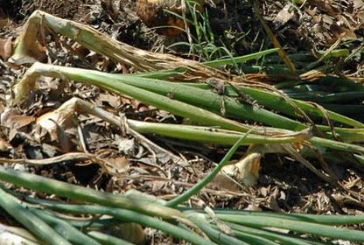
Harvest index for onions
Harvest index for onions: Onion tops will fall over when the crop is nearly ready to harvest. Allow the leaves to dry out and turn brown before harvesting.
(Photo credit: Lisa Kitinoja)
Mod. 1.4 Slide 6

Slide 8
Harvesting practices
Poor timing and using poor methods and tools to harvest F&V can damage the crops and lead to increased postharvest losses.
Time: harvest early in the morning when it is typically cooler and less stressful to F&V crops
Tools: knives and clippers should be sharp and kept clean
Picking bags: using shoulder harnessed harvesting bags can reduce damage
Workers: should be well trained in how to harvest without causing damage and on how to keep their hands and fingernails clean; should wash before touching the crop to harvest, and wash their hands again after using the toilet or touching anything that is unsanitary
Field containers: should be clean, smooth on the inside and kept up off the soil (placed on pallets or tarpaulins) to prevent contamination and food safety problems
Mod. 1.4 Slide 7

Slide 9
Harvesting tools
Six types of produce harvesting knives. Curved blades and blunted tips can help reduce damage. Source: www.harrisseeds.com
Mod. 1.4 Slide 8

Slide 10
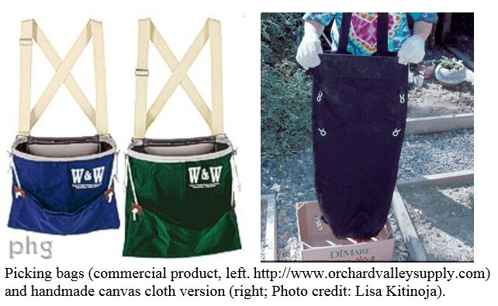
Harvesting bags
These picking bags are harvesting aids that can be made by sewing heavy canvas or vinyl bags with openings on both ends, and fitting the bags with simple shoulder straps or adjustable harnesses.
When the bag is full, the two bottom straps are released and the produce can roll gently out of the bag and into a waiting field container.
Mod. 1.4 Slide 9

Slide 11
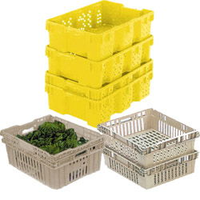
Field Containers
Using field containers that are sturdy, smooth on the inside and easy to clean can help to reduce postharvest losses for F&V crops. Well ventilated containers are preferred.
A selection of field containers, in different styles and sizes.
Sources: www.thunderbirdplastics.com and www.tedthorsen.com
Mod. 1.4 Slide 10

Slide 12
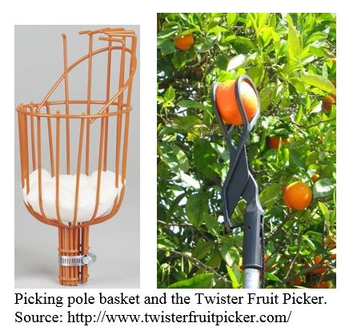
Gentle harvesting
Mechanical damage during harvest can become a serious problem, as injuries predispose produce to decay, increased water loss and increased respiration and ethylene production rates.
Mod. 1.4 Slide 11

Slide 13
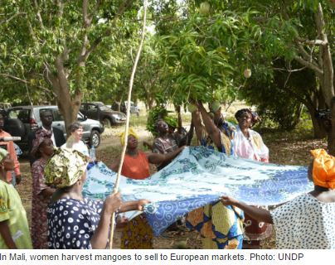
Cloth to catch fruits during the harvest in Mali
Photo source:
UNDP
Mod. 1.4 Slide 12

Slide 14
Sorting
There are two types of sorting used to reduce postharvest losses
Pre-sorting to remove damaged and decayed produce:
packing damaged, insect infested or decayed foods in the same container with good quality foods will spread disease or insects to the entire load.
Sorting to match market demand:
tomatoes harvested red ripe will have a very short postharvest life and be susceptible to bruising and crushing during transport and marketing, so they are typically harvested only for immediate use.
Mod. 1.4 Slide 13

Slide 15
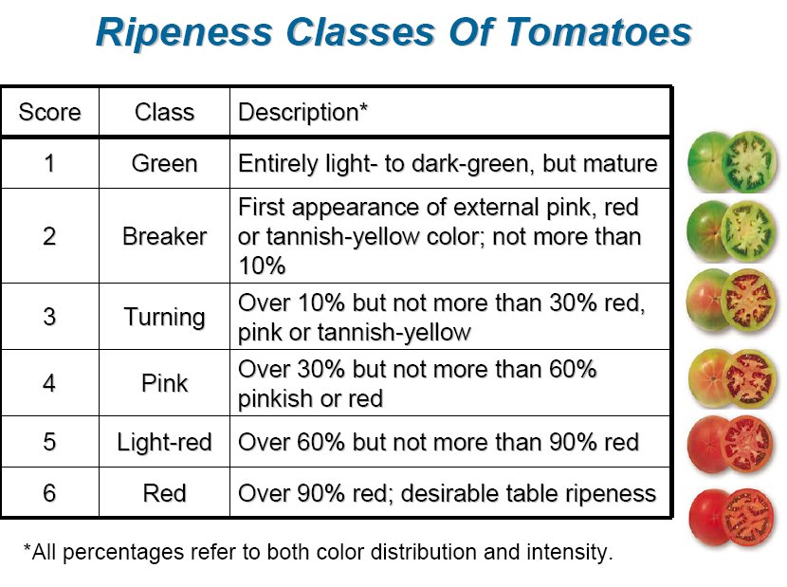
Example: Sorting tomato fruits after harvest
Sorting tomato fruits after harvest can enhance market value and shelf life:
Red ripe – for local processing or home consumption
Pink – sell in nearby markets
Breaker/turning - for marketing a few days later or to sell in a long distant market
Mature green – for short term storage before marketing
Rating scale for tomato ripeness (Source:
UC Davis)
Mod. 1.4 Slide 14

Slide 16
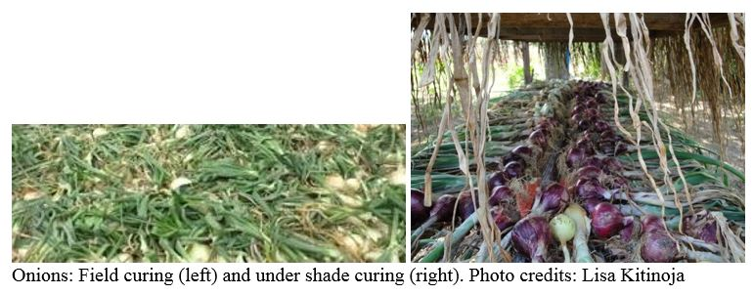
Curing onions and garlic
Curing, when used for preparing onions and garlic for storage or marketing, refers to the practice directly following harvest of allowing the external layers of skin and neck tissue to dry out prior to handling and storage.
If local weather conditions permit, these crops can be undercut in the field, windrowed and left there to dry for five to ten days.
The tops of the plants can be arranged to cover and shade the bulbs during the curing process, protecting the produce from excess heat and sunburn.
If the weather is rainy or too hot, onions and garlic can be cured in an open sided shed or under a simple shade cover.
Mod. 1.4 Slide 15

Slide 17
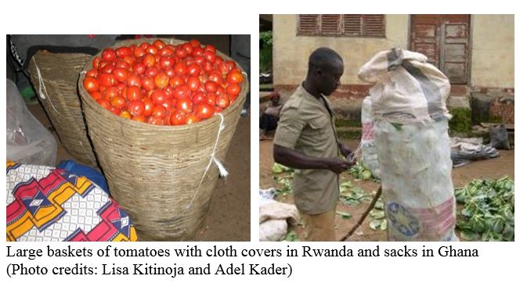
Field containers and packages
Baskets and sacks offer little or no protection for handling F&V crops after the harvest. When baskets are stacked on top of one another, the produce inside, especially in the lower layers, is compressed and can be crushed.
Mod. 1.4 Slide 16

Slide 18
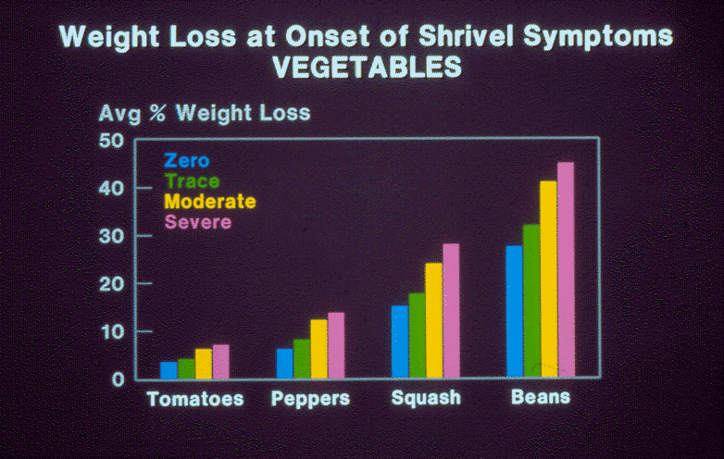
Use of shade
Exposure of fresh F&V to the sun after harvesting will lead to heat gain, water loss and weight loss. If a trace of shrivel symptoms are noticeable in tomatoes, a weight loss of 4 to 5% has already occurred. If a trace of shrivel is observed in green beans, more than 30% losses due to weight loss has occurred.
Source: UC Davis postharvest outreach program slide set archives (circa 1980)
Mod. 1.4 Slide 17

Slide 19
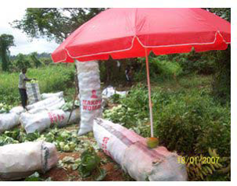
Use of shade
Since wholesale buyers travel and visit various farms and fields to buy fresh produce, it can be convenient to use shade umbrellas.
In Ghana, a shade umbrella costs about 20 Ghanaian cedis (20 cedits = US$15) and can protect F&V crops from heat gain and water loss after harvesting and during on-farm delays, sorting and packing.
Photo credit: Hussein AlHassan
Mod. 1.4 Slide 18

Slide 20
Reducing postharvest losses during (2) storage
Pre-cooling
Heat treatments and bicarbonate salts for disease management
Curing onions and garlic before long-term storage
Evaporative cool storage of tropical and sub-tropical F&V
Commercial cold rooms for temperate F&V
Self-built cold rooms
Improved containers
Avoiding storage of incompatible mixed loads
Inspection and resorting
Mod. 1.4 Slide 19

Slide 21
Pre-cooling
Whenever warm produce is placed inside a cold room, the refrigeration unit is stressed by the amount of heat that has to be removed from the room.
Pre-cooling is a postharvest technology that removes the majority of heat from packed produce before the load is placed into a cold storage room.
It is possible to pre-cool F&V using cold water, cold air or ice.
Hydro-cooling
Evaporative cooling
Forced air cooling
Use of ice
Mod. 1.4 Slide 20

Slide 22
Hydro-cooling
Hydro-cooling provides fast, uniform cooling for some F&V crops.
The commodity as well as its packaging materials must be tolerant of wetting, chlorine (used to sanitize the hydro-cooling water) and water beating damage.
The water used for hydro-cooling must be clean, very cold and kept sanitized by adding chlorine. Unsanitary water or warm water increases the risk of creating a favorable environment the growth of microorganisms, especially warm weather or hot climates.
Chlorination of wash water is very important.
Mod. 1.4 Slide 21

Slide 23
Mixing chlorine solutions for washing fresh produce
Typically 1 to 2 ml of chlorine bleach per liter of clean water will provide 100 to 150 ppm total Cl. More chlorine will be required if temperatures are high or if there is a lot of organic matter in the wash water (Kitinoja & Kader 2015).
Source: Ritenour, M.A., S.A. Sargent and J.A. Bartz. 2014. Chlorine Use In Produce Packing Lines. UF/IFAS HS-761. https://edis.ifas.ufl.edu/ch160
Mod. 1.4 Slide 22

Slide 24
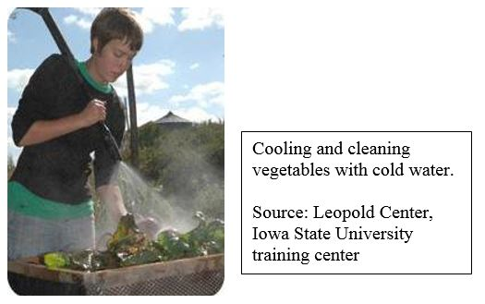
Hydro-cooling
The simplest versions of hydro-cooler is a hand-held water spray from a hose pipe, or a tank of cold water in which produce is immersed.
Mod. 1.4 Slide 23
Notes:
Sources: Iowa State University www.leopold.iastate.edu

Slide 25
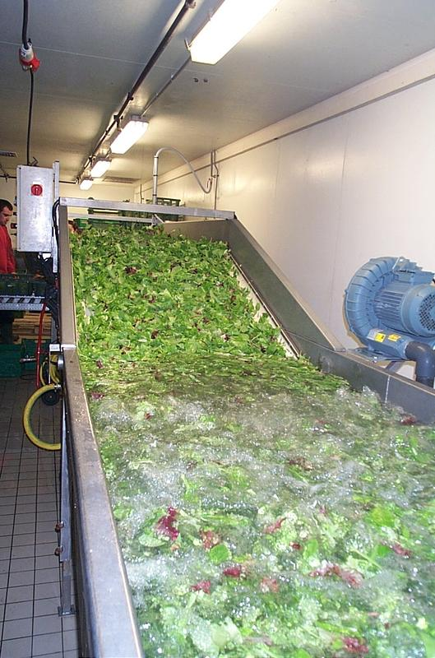
Immersion type hydro-coolers
Small scale and large scale immersion style hydro-coolers.
Sources: Iowa State University www.leopold.iastate.edu ; Groupe Claire Fontaine www.machines-briand.com
Mod. 1.4 Slide 24

Slide 26
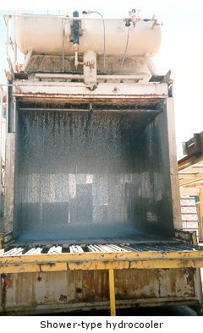
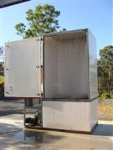
Shower type hydro-coolers
A shower type hydro-cooler showers a batch of produce with icy water. Sources: www.fao.org ; www.weiku.com
Mod. 1.4 Slide 25

Slide 27
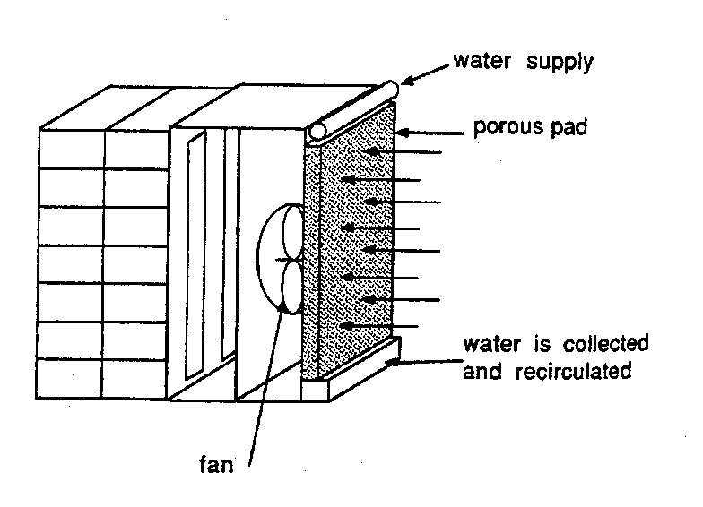
Evaporative cooling using electricity
Evaporative coolers can be constructed to cool the air in an entire storage structure or in just a few containers of produce.
These coolers are best suited to lower humidity regions, since the degree of cooling is limited to 1 to 2° C above the wet-bulb temperature.
Sources: Thompson and Kasmire 1981; Mitchell in Kader, 1992.
Mod. 1.4 Slide 26

Slide 28
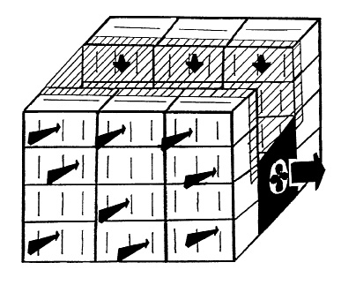
Forced air (FA) cooling
Pre-cooling can be accomplished quickly by using a portable forced air cooler, placed inside a cold room.
Many different sizes of FA coolers can be constructed, using a portable box style fan and a piece of heavy plastic sheeting.
FA Cooling tunnel for 24 cartons or crates of F&V. Source: aces.nmsu.edu
Mod. 1.4 Slide 27

Slide 29
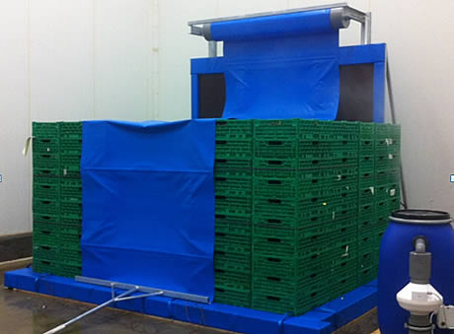
Portable FA Cooler
A portable forced air cooler should be located so the cold air in the cold room blows up over the top of the load. The air is pulled into the center of the tunnel by a small fan. The only way the air can get into the tunnel is to pass through the cartons or crates of produce.
Larger scale unit: AB Speedbox Forced Air Cooler. Source: AB Coolservice (Belgium) www.abweb.be
Mod. 1.4 Slide 28

Slide 30
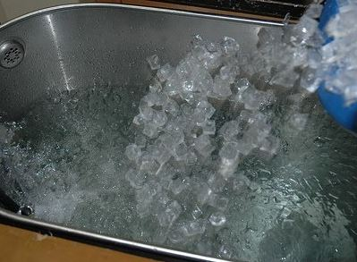
Use of ice
Ice can be used for cooling:
directly as package ice (only for temperate vegetables such as green onions, spinach, turnip greens, chard, mustard greens, broccoli and radishes)
to cool water for use in a hydro-cooler (for crops that are water tolerant such as stone fruits, pome fruits, sub-tropical fruits, leafy vegetables, lettuces, green onions, green beans, melons, sweet corn)
as an ice bank for a small forced air or room cooling system.
Melting 1 kg of ice made from water has the cooling effect of 315 Btu.
One kg of ice will drop the temperature of produce 3 times its weight by about 28°C.
Using ice to cool water for use in a hydro-cooler
Mod. 1.4 Slide 29

Slide 31
Hot water or hot air treatment
High temperature may be used to control postharvest decay on crops that are injured by low temperatures, such as mango, papaya, pepper, and tomato (Spotts 1984).
Heat treatments must always be followed immediately by cooling (hydro-cooling or forced air cooling) to bring the temperature down.
Mod. 1.4 Slide 30

Slide 32
Postharvest decay control
The use of bicarbonate salts for prevention of postharvest decay has been used on fresh peppers, melons, potatoes, carrots and citrus fruits. These salts are very inexpensive, safe to use, readily available and accepted as “certified organic” and “chemical free” for marketing purposes.
Bicarbonate salts include:
Bicarbonate of soda, or “baking soda” (NaHCO₃)
Potassium bicarbonate (KHCO₃)
Mod. 1.4 Slide 31

Slide 33
Curing onions and garlic before long-term storage
If forced heated air is used for curing onions and other bulbs, one day or less at 35 to 45 °C and 60 to 75% relative humidity are recommended. The dried layers of 'skin' can then protect the produce from further water loss during storage.
Onions and garlic prefer lower RH storage conditions (65-70%), and a higher RH% in storage will lead to decay and rapid deterioration.
Providing shade, good ventilation and raising the storage room up off the ground will provide a beneficial storage environment.
Curing conditions for onions and garlic are WARM and DRY
Mod. 1.4 Slide 32

Slide 34
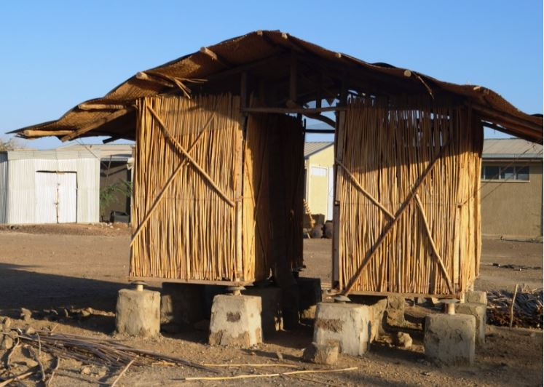
Ventilated onion storage
The ventilated onion storage structure shown in the photo (in Semera, Ethiopia) allows onions to be stored at ambient temperature for about 3 months with minimal postharvest losses.
Design adapted from storage structures being promoted in India, and construction organized by Mekbib Seife Heilegebrile.
(Photo credit: Lisa Kitinoja)
Mod. 1.4 Slide 33

Slide 35
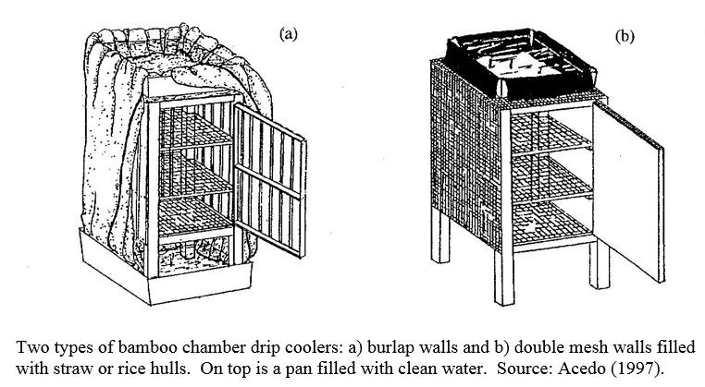
Evaporative cool storage of tropical and sub-tropical F&V
These crops will have enhanced storage life when the temperature is maintained at 12 to 15°C. In dry climate zone and during the dry season in many countries in SSA, these temperatures can be achieved using simple evaporative cooling practices.
Evaporative coolers can be constructed from simple materials, such as burlap and bamboo. A "drip cooler" operates solely through the process of evaporation, without the use of a fan.
Mod. 1.4 Slide 34

Slide 36
Natural forms of low cost cool storage
Radiant cooling: Can be used to lower the air temperature in a storage structure if a solar collector is connected to the ventilation system of the building. By using the solar collector at night, heat will be lost to the environment. Temperatures inside the structure of 4 °C less than night temperature can be achieved.
Use of well water: Well water is often much cooler than air temperature in most regions of the world. The water temperature of a deep well tends to be in the same range as the average air temperature of the same locality. Well water can be used for hydro-cooling and as a spray or mist to maintain high relative humidity in the storage environment.
High altitude storage: Typically, air temperatures decrease by 10 °C for every one kilometer increase in altitude. If handlers have an option to pack and/or store F&V at higher altitude, cool storage costs could be reduced. Cooling and storage facilities operated at high altitude would require less energy than those at sea level for the same results.
Mod. 1.4 Slide 35

Slide 37
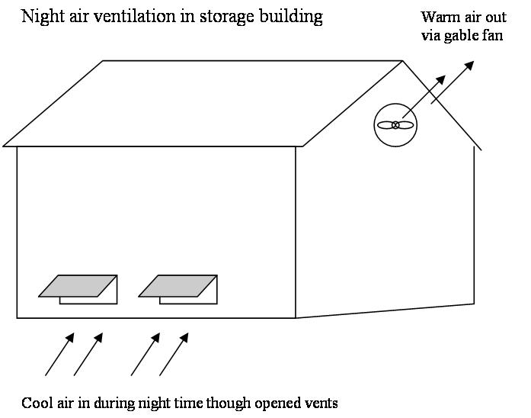
Night air ventilation
The storage facility should be well insulated and vents should be located at ground level. Vents can be opened at night, and fans can be used to pull cool air through the storeroom.
The structure will best maintain cool temperatures during the heat of the day if it is very well insulated and vents are closed early in the morning when the air temperature is still low.
As a rule, night air ventilation effectively maintains product temperature when the outside air temperature is below the desired product temperature for 5 to 7 hours per night.
Source: Kitinoja and Kader (2003)
Mod. 1.4 Slide 36

Slide 38
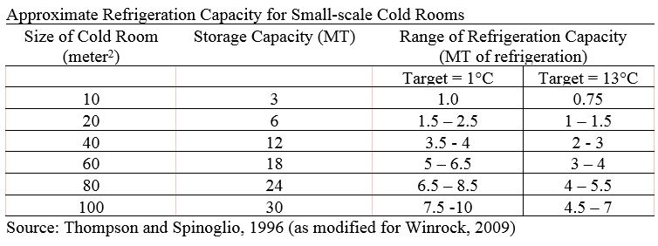
Commercial cold rooms for temperate F&V
The cost of constructing and operating cold rooms will depend upon the size of the room, the set temperature required for what is being stored, and the refrigeration technologies utilized.
The range of tons of refrigeration shown in the table reflects the climate in which the cold room is located. A standard metric tonne (MT) of refrigeration equals 12,000 BTU/hour, equivalent to about 3.5 kW.
Mod. 1.4 Slide 37

Slide 39
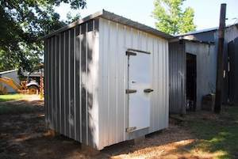
Self-built cold rooms
Commercially constructed cold rooms can be very expensive, costing about US$ 30,000 for a small walk-in size room.
Winrock (2009), WFLO (2010) and the Horticulture Innovation Lab (2014) have published information on self-built cold rooms using the CoolBot™ controller, and an 18,000 BTU window style air conditioning unit.
These cold rooms can be constructed for about 10% of the cost for a commercial cold room.
Example of a self-built cold room. Source: http://storeitcold.com/coolerconstruction.html
Mod. 1.4 Slide 38

Slide 40
Improved containers for proper storage management
Overloading storage structures for F&V, or packing the cool room with assorted types of containers that cannot be properly stacked and organized will lead to higher postharvest losses.
The lot of produce placed into storage must not contain damaged or diseased F&V, and containers must be well ventilated and strong enough to withstand stacking.
In general, proper storage practices include temperature control, relative humidity control, air circulation and maintenance of space between containers for adequate ventilation, and avoiding incompatible product mixes.
Mod. 1.4 Slide 39

Slide 41
Avoiding storage of incompatible mixed loads
Commodities stored together should be capable of tolerating the same temperature, relative humidity and level of ethylene in the storage environment.
High ethylene producers (such as ripe bananas, mangoes, tomatoes) can stimulate physiological changes in ethylene sensitive commodities (such as lettuce, cucumbers, carrots, potatoes, sweetpotatoes) leading to often undesirable color, flavor and texture changes.
Mod. 1.4 Slide 40

Slide 42
Inspection and resorting
F&V crops are perishable in nature and generally cannot be kept in storage for a long time.
It is important to perform regular inspections of the storage structure, check the produce for decay or damage, and remove any produce that is ripe and ready to eat.
Mod. 1.4 Slide 41

Slide 43
Reducing postharvest losses during (3) transportation
Improved containers
Loading/unloading
Stacking, ventilation
Covering open loads
Proper handling and transport of mixed loads
Traders are generally in charge of postharvest handling during transportation. As a rule, traders are rarely included in postharvest extension/training programs, and they can be a difficult clientele group to reach, since they are usually on the move from farm to farm and market to market, and rarely have time to attend long meetings or classroom style educational programs.
Mod. 1.4 Slide 42

Slide 44
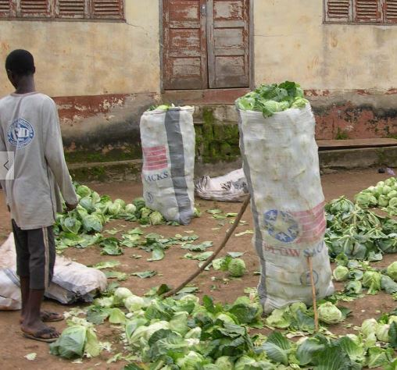
Improved containers
Cabbages in Ghana are typically packed in enormous enlarged sacks, each weighing up to 100kg.
During FLA in Tamale (northern Ghana), half sized sacks were shown to suffer lower rates of head splitting, and averaged 23% losses in small sacks vs 32% losses in large sacks when assessed after transport (WFLO, 2010).
Mod. 1.4 Slide 43
Photo credit: Adel Kader

Slide 45
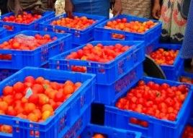
Plastic crates
The GEM4 project in Nigeria is using well ventilated plastic crates to pack, transport, store and market tomatoes.
“Transportation of tomatoes in raffia baskets result in 41% of tomatoes being lost in transit from North to South but with plastic crates, losses have been reduced to 5%,” (DFID, 2015).
In addition, market prices for tomatoes sold in plastic crates can be twice as much as for tomatoes sold in baskets.
GEMS4 tomato crates in Nigeria (DFID 2015)
Mod. 1.4 Slide 44

Slide 46
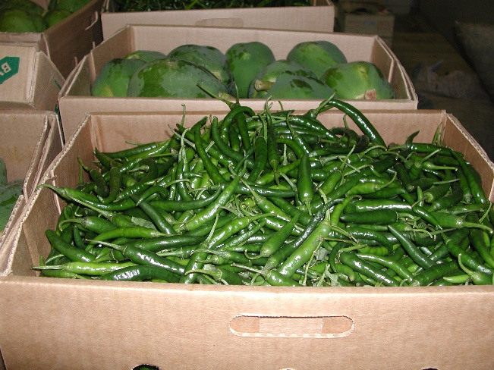
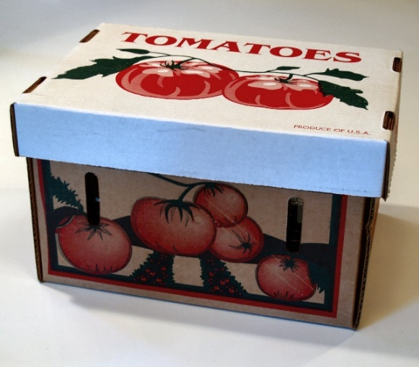
Fiberboard cartons
The best design for a fiberboard carton will include venting on all 4 sides (about 5% of the surface area, with a few vertically placed long oval vents), cut outs for hand holds to make lifting and stacking easier for workers.
www.proagonlin.com
Mod. 1.4 Slide 45
Photo credit: Lisa Kitinoja

Slide 47
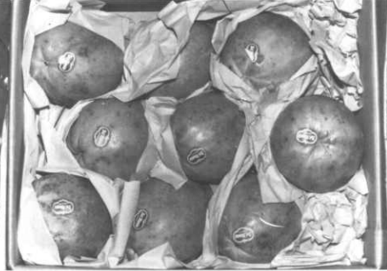
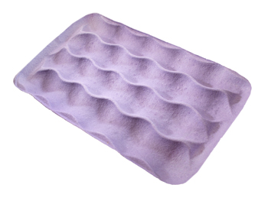
Liners, trays and wraps
For delicate F&V that need extra protection, package liners, trays, paper wraps or dividers can be added to a standard crate or carton.
Mod. 1.4 Slide 46

Slide 48
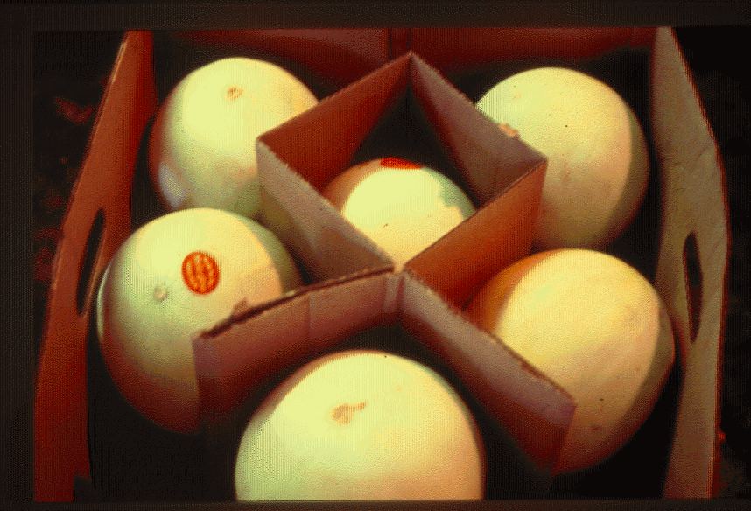
Package dividers
Simple package dividers can be used to provide extra protection for F&V and improve the stacking strength of containers.
Mod. 1.4 Slide 47
Notes:
(Source: USDA Handbook 668) http://naldc.nal.usda.gov/download/CAT89930509/PDF

Slide 49
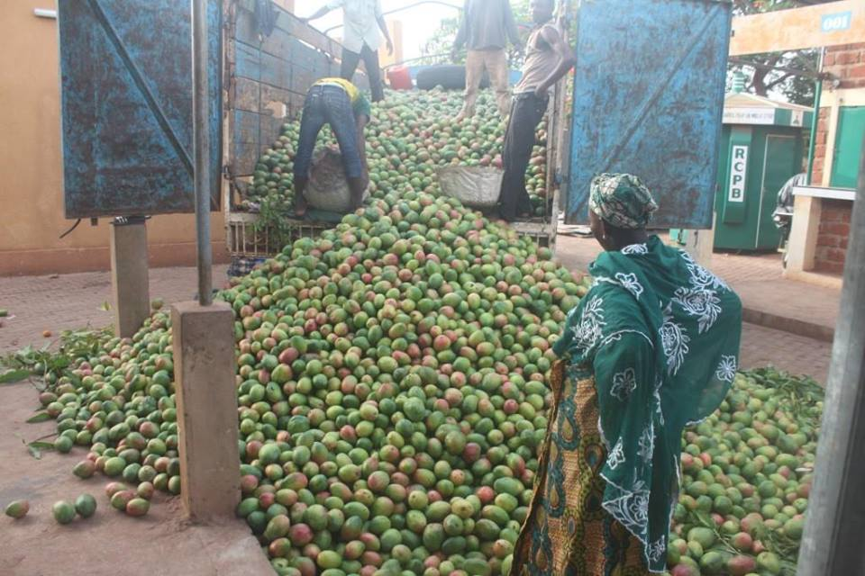
Loading/unloading vehicles
Avoid overloading vehicles or stacking produce too high.
If it is a bulk load, produce in a large pile will gain heat during transport, from friction, the sun and from natural process of respiration.
If it is an open load, cover the top with a large canvas cloth or plastic tarpaulin. If a cover is not available, it may be possible to use plant materials such as banana leaves.
Unloading a bulk shipment of mangoes in Burkina Faso (2015)
Mod. 1.4 Slide 48

Slide 50
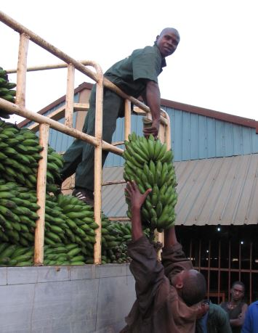
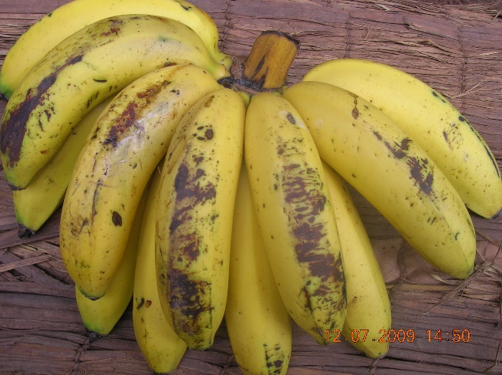
Unloading bananas
Bananas in Rwanda are bruised by very rough handling during loading, throwing bunches, stacking the load too high, loading vehicles too densely, walking on the load -- all of which cause postharvest losses (WFLO 2010).
No packaging is used for plantains in Ghana or for bananas in Rwanda, and the fruits often suffer broken tips, cracks and bruises as they move along the value chain.
Damage to bananas during transport in bulk loads in Rwanda (WFLO 2010)
Mod. 1.4 Slide 49
Photo credit: Dan McLean

Slide 51
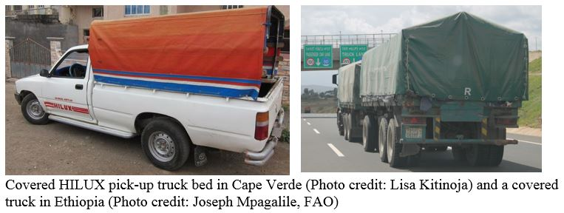
Covering open loads
Protecting F&V crops from direct sunlight, wind and dust can help to reduce postharvest losses.
Mod. 1.4 Slide 50

Slide 52
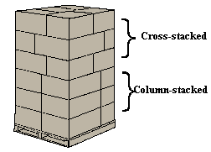
Stacking packaged F&V crops
Proper stacking of packages will help reduce damage and food losses.
Cartons should not hang over the edge of the pallet, and the corners should line up when stacked on top of one another.
Using uniformly sized packages makes proper stacking easier.
Source: North Carolina State University (www.bae.ncsu.edu )
Mod. 1.4 Slide 51

Slide 53
Reducing postharvest losses during (4) agro-processing
Preparation for processing
Improved solar drying
Heat processing
Improved food safety
Improved packages and containers
Mod. 1.4 Slide 52

Slide 54
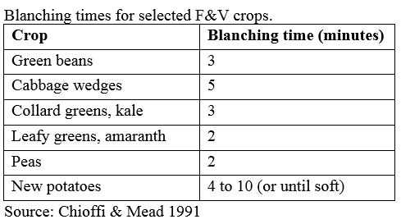
Preparation for processing
Some produce requires blanching before freezing, canning or drying.
Blanching by boiling water bath or in steam ends certain enzymatic reactions in the product and helps retain color and flavor after processing. Always rinse blanched produce under very cold water or dip blanched produce into an ice water bath to stop the cooking process and quickly bring the temperature down.
Blanching time for each commodity varies, depending upon its physical structure (see table below for examples). Use 8 liters of boiling water per kg of produce, and add one minute for each 650m altitude for elevations over 1200m
Mod. 1.4 Slide 53

Slide 55
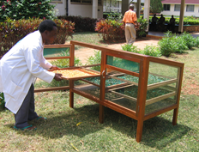
Improved solar drying
Traditional sun drying in SSA often involves laying produce on the ground, either directly on the soil or on a cement pad. This exposes the F&V crops to contamination from soil, dust, insects and birds.
Simple direct driers can be made from trays of screening material propped upon wooden or concrete blocks to allow air to circulate under the produce.
When air can pass over and below the produce, drying will speed up and there will be reduced losses due to overheating. A layer of cheesecloth can be draped loosely over the produce, protecting it from insects and birds while drying.
Check the produce each day, and move it under cover if rain threatens.
Solar drier in Tanzania (a direct model). Photo credit: Lisa Kitinoja
Mod. 1.4 Slide 54

Slide 56
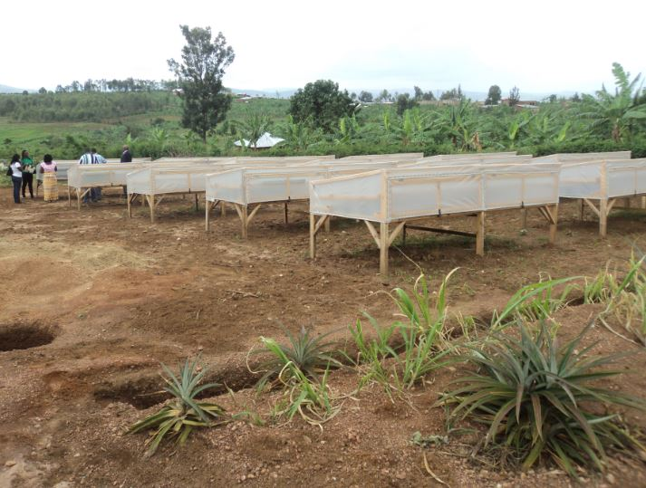
Commercial scale solar drying
In Rwanda, postharvest training on solar drying of pineapples resulted in the adoption of improved solar drying practices and the launch of a massive solar drying business for organic pineapple exports.
Pineapple solar drying operations (Photo credit: Herve Ineza, 2014)
Mod. 1.4 Slide 55

Slide 57
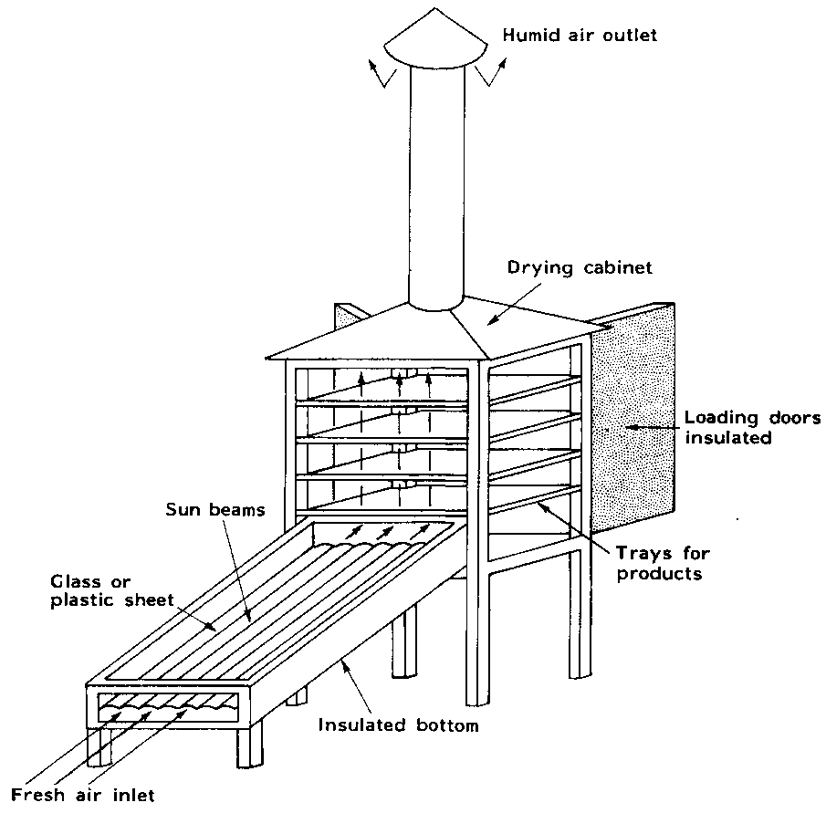
Indirect solar driers
Another improved solar drier is an indirect model, where the produce is protected from direct sunlight, and a solar collector heats air before it enters the drying chamber.
Usually the drying takes place on trays stacked inside a cabinet style chamber, and solar heated air passes upward through the trays, carrying away the water in the drying produce.
Mod. 1.4 Slide 56
Indirect style solar drier (FAO)

Slide 58
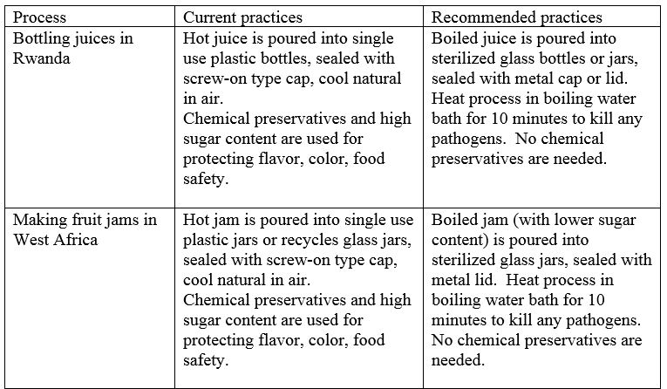
Heat processing
Canning and bottling operations in SSA are often carried out without using heat processing.
This practice is thought to save money, but it leads to poor quality products with short shelf life, and can be dangerous in terms of food safety.
Mod. 1.4 Slide 57
Notes:
Please refer to Manual 5b for more examples.

Slide 59
Aflatoxin management
Aflatoxins can be a problem in dried vegetable crops if they are not properly dried and protected from moisture during storage and marketing. A highly toxic metabolite produced by the ubiquitous Aspergillus flavus fungus is a major public health issue in Africa.
IITA (2009) provides details on mycotoxins found in dried vegetable crop products in the wholesale markets of Togo.
The Aspergillus flavus fungus infects crops and produces the toxin in the field and in stores, then the fungus is carried from field to store. Contamination is possible without visible signs of the fungus, and very low levels are toxic (maximum allowable levels = 20 ppb US; 10 ppb WFP; 4 ppb EU).
Mod. 1.4 Slide 58

Slide 60
Aflatoxin management
Some predisposing factors for aflatoxin contamination:
pre-harvest high night-time temperatures and drought stress
wet conditions at harvest and post-harvest periods
insect or bird damage
rain on the mature crop increases contamination.
associated with high humidity in the field & store, insect damage, and improper crop storage or transportation.
Source: PACA and IITA
Mod. 1.4 Slide 59

Slide 61
Improved food safety
There are global standards for food safety, and protocols have been developed by many countries for domestic food processing and markets. An entire training program is required for complete coverage of the subject, but the following key points need to be protected against in order to ensure safe postharvest handling of F&V crops.
Physical Hazards
Nails, screws, pieces of glass, wood splinters etc.
Chemical Hazards
Pesticides, fungicides, machine lubricants, heavy metals, cleaning compounds etc.
Human Pathogens
Soil associated bacteria (Clostridium botulinum, Listeria monocytogenes)
Fecal associated bacteria (Salmonella spp., Shigella spp., E. coli 0157:H7 etc.)
Mod. 1.4 Slide 60

Slide 62
Improved packages and containers for processed products
Improved containers for processed products such as jams, jellies, preserves and juices have the following characteristics:
Made from glass of high quality (thick, free of chips or cracks) that can be heat processed without breaking
Made of metal (if the required sealing equipment is available)
Metal, glass or plastic lids that fit tightly, and seal well to the container when heated
Reusable if possible, especially for processed foods produced for home use or local sale and packaged glass jars or bottles
Recyclable if metal or single use glass
Mod. 1.4 Slide 61

Slide 63
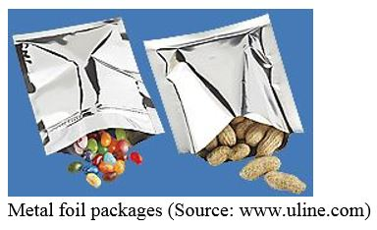
Containers for dried F&V products
Containers for dried F&V products that can be sealed and protect the dried products from light, water, insects and rodents will greatly increase their storage life.
Metal foil packages are non-toxic (Castle 1982), low cost (UD$0.05 to $0.10 per package depending upon size) and can protect dried F&V and other dry food products for up to one year (USU 2013).
Mod. 1.4 Slide 62

Slide 64
Reseal-able containers
Plastic buckets can be cleaned and reused many times for storage of dried foods. Typically, the plastic lids will break after a few uses.
A new type of lid for plastic buckets of several sizes, known as a gamma-seal, can be permanently attached to a bucket, and then the center portion can be screwed on and off whenever needed without damaging the container or the lid.
Mod. 1.3 Slide 63

Slide 65
Reducing postharvest losses during (5) wholesale and retail marketing
Temperature management practices
Sanitation
Inspection and resorting
Mod. 1.4 Slide 64

Slide 66
Temperature management practices
Keeping fresh produce cool is a key to extending the shelf life and reducing postharvest losses for F&V crops.
Produce exposed to the sun after harvest gains an enormous amount of heat and will have reduced shelf life.
Tomatoes left in the sun for one hour after harvest will be at least 15°C hotter than fruit held in the shade (Kitinoja and Kader, 2003).
Mod. 1.4 Slide 65

Slide 67
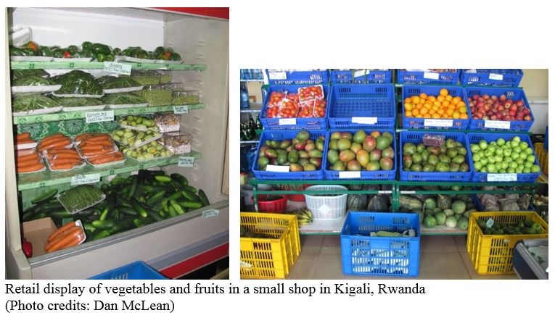
Sanitation, inspection and resorting
Fresh F&V will slowly deteriorate and lose quality during the marketing period.
It is important to keep the sales and temporary storage areas clean, and to sanitize the displays and storage areas between uses.
During the course of a typical marketing day, produce may need to be inspected, with any damaged/decayed items sorted out and discarded to prevent the decay from any affected F&V from spreading to the rest of the lot.
Mod. 1.4 Slide 66

Slide 68
How to work with and train the 5 target groups
Details on how to work with and train the 5 target groups/beneficiaries to reduce postharvest food losses
(1) small-holder farmers
(2) village and community storage operators
(3) micro, small and medium enterprises
(4) small stores
(5) market and street vendors (excluding supermarkets)
The majority of postharvest losses for F&V crops in SSA will be experienced by small-holder farmers, traders, village/community storage operators and marketers. Relatively low levels of postharvest losses occur during agro-processing of F&V crops.
Mod. 1.4 Slide 67

Slide 69
Improved postharvest practices of F&V crops for (1) small-holder farmers
Several practices are highly recommended for the focus of training programs aimed at assisting smallholder farmers to reduce postharvest losses.
Use of harvest indices
Gentle handling
Plastic crates
Use of shade
On-farm storage
Market access
Mod. 1.4 Slide 68
Notes:
The first four topics were introduced and discussed in detail earlier in this module. For further information, trainers can refer to the following training manuals:
Small-scale postharvest handling practices: a manual for horticultural crops.
English: http://ucanr.edu/sites/Postharvest_Technology_Center_/files/230101.pdf
French: http://ucanr.edu/sites/Postharvest_Technology_Center_/files/230102.pdf
Amharic: http://ucanr.edu/sites/Postharvest_Technology_Center_/files/230098.pdf
Afrikaans: http://ucanr.edu/sites/Postharvest_Technology_Center_/files/230097.pdf
Swahili: http://ucanr.edu/sites/Postharvest_Technology_Center_/files/230107.pdf

Slide 70
Market access
Smallholder farmers often have limited knowledge regarding market prices and consumer demand or preferences.
Advocating and promoting the formation of farmer’s groups as formal or informal associations, cooperatives or small businesses is one approach to improving access to markets (WFLO 2010, Ferris et al 2014).
Promoting a market-driven approach not only helps to improve access but ensures there is sufficient market demand for the products.
A market-oriented approach can demonstrate economic and technical feasibility, hence a higher adoption rate and improved sustainability.
Mod. 1.4 Slide 69

Slide 71
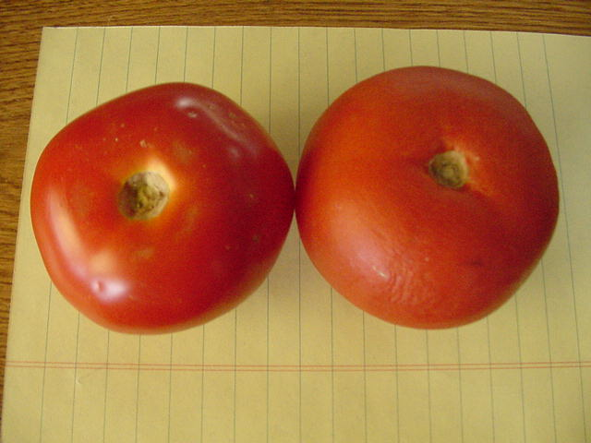
Learning of Doing Demonstration: Use of shade
Fresh F&V exposed to sun, heat and dry air will lose water quickly, and will soon wilt, become dull or shriveled. Tomatoes lose their shiny appearance, leafy crops become limp, and green beans lose weight.
Postharvest trainers can set up a simple demonstration at the beginning of a program by putting one sample in the shade, and a second sample in the sun, and have visual results in a few hours. Participants are shown how to feel and/or measure the temperature of produce after it has spent a few hours in the sun, and compare this to the cooler temperatures of the same produce that has been kept in the shade. A digital scale can be used to measure the initial and final weight of the produce sample.
Mod. 1.4 Slide 70

Slide 72
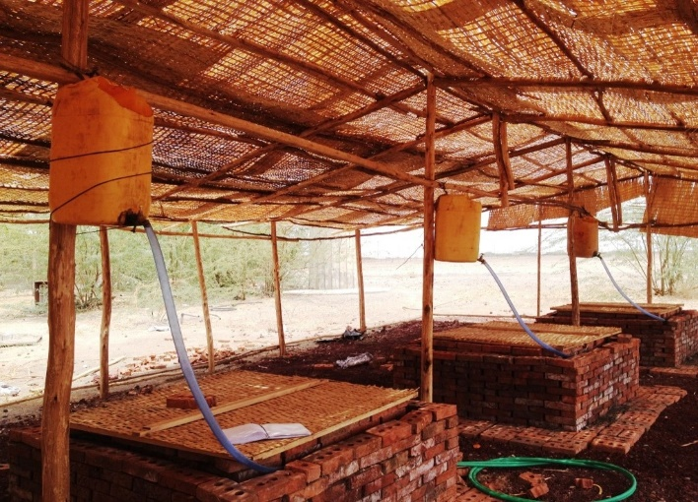
On-farm storage
Farmers may need to keep fresh produce overnight or for a few days before sale to traders or direct marketing. In drier climates, the use of simple evaporative cool storage structures can provide up to 10ºC reduction in temperature, which will double the postharvest life and reduce losses due to water loss and decay.
In the semi-desert region of Afar, Ethiopia, three on-farm cool storage technologies were demonstrated side by side (pot in pot, cool shelf, ZECC), and each was able to reduce the storage temperature and increase RH% for a period of up to 24 days.
Zero Energy Cool Chambers
Photo credit: Mekbib Seife (2015)
Mod. 1.4 Slide 71
Notes:
Please refer to Manual 5b for more details and photos.

Slide 73
Improved postharvest handling practices for (2) village and community storage operators
Temperature and relative humidity management
Plastic crates to protect perishable crops
Sanitation
Inventory management
Use of simple tools for moving packed F&V
Mod. 1.4 Slide 72

Slide 74
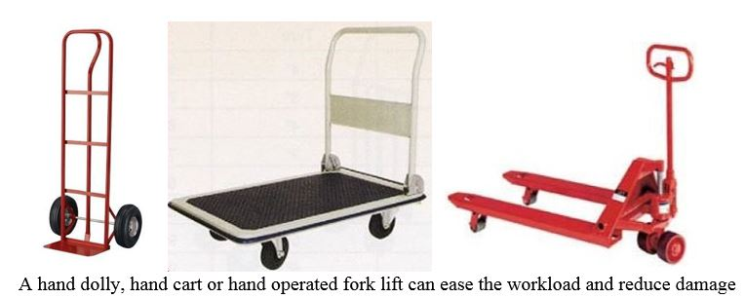
Demonstrations of reduced F&V losses
One example is the use of simple tools for moving packed F&V crops. The cost of the unit and the associated losses from physical damage can be compared to manual handling (cost of labor and level of damage).
Illustration Source: www/uline.com
Mod. 1.4 Slide 73

Slide 75
Improved postharvest handling practices for (3) micro, small and medium enterprises
Gentle handling
Reducing delays
Packinghouse operations
Use of improved packages and containers
Food safety
The volume of crops that requires handling or processing will often determine which technologies make the most sense economically.
Mod. 1.4 Slide 74

Slide 76
Gentle handling and reducing delays
Any time the crop is left waiting in the sun, in a truck, on a loading dock, or dropped, thrown or stacked too high, postharvest losses will tend to increase.
Planning the timing of harvesting and deliveries to the packinghouse, processing plant, distribution center or market will help reduce unnecessary delays.
Mod. 1.4 Slide 75

Slide 77
Packinghouse operations
There is no one packinghouse design that will work well for every kind of fruit and vegetable crop, but following a few simple guidelines can help to reduce postharvest losses.
Design packing lines to have a one way flow
Avoid unneeded steps in the packing process (keep it simple) to prevent damage
Avoid drops, throws and bumps by getting the produce close to workers so they can easily reach and gently place the produce into the packages
Provide plenty of workspace (sufficient elbow room) and lighting for workers to do their jobs
Keep the facility clean, whether it is a simple outdoor shed or a complication mechanized system
Mod. 1.4 Slide 76
Notes:
The figure in Manual 5b shows a simple design of a packing house.

Slide 78
Examples of appropriate packinghouse operations for F&V crops in SSA
Mod. 1.4 Slide 77

Slide 79
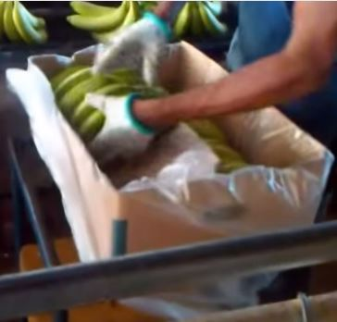
Use of improved packages and containers
Package liners can help reduce water loss in F&V crops. Lightweight or vented liners will decrease water loss without seriously interfering with oxygen, carbon dioxide and ethylene movement.
Video of bananas being packed into cartons (Source: Fresh 'n' Smart®):
https://www.youtube.com/watch?v=CZKPI0fKKM8
Mod. 1.4 Slide 78

Slide 80
Food safety
Food safety starts on the farm with Good Agricultural Practices (GAPs), and must be protected all the way through processing (HACCP) to the final consumer.
Physical Hazards
Nails, screws, pieces of glass, wood splinters etc.
Chemical Hazards
Pesticides, fungicides, machine lubricants, heavy metals, cleaning compounds etc.
Human Pathogens
Soil associated bacteria (Clostridium botulinum, Listeria monocytogenes)
Fecal associated bacteria (Salmonella spp., Shigella spp., E. coli 0157:H7 etc.)
Mod. 1.4 Slide 79
Notes:
For further information:
Cornell University GAPs Program (includes self-assessments).
http://www.gaps.cornell.edu/Farmassessmentws.html
HACCP: Example protocol for juice processing http://www.fda.gov/Food/GuidanceRegulation/GuidanceDocumentsRegulatoryInformation/ucm072557.htm

Slide 81
Improved postharvest handling practices for (4) small stores/shops and for (5) market and street vendors
Inventory management
Temperature management/ use of shade
Sanitation
Displays/use of tables and shelves
Mod. 1.4 Slide 80

Slide 82
Inventory management
Fresh produce has a limited postharvest life, even when handled and stored under the best conditions (kept cool and at high relative humidity).
Small stores and open air retail markets rarely can provide these conditions, and so the F&V on display will tend to lose water and begin to look less appealing to customers.
Keeping good records and using a first-in/first out inventory management system will help reduce postharvest losses.
Mod. 1.4 Slide 81

Slide 83
Temperature management/ use of shade
Keeping produce cool during marketing is difficult for vendors, but nature can provide some assistance.
Using shade will help keep temperatures lower, and using evaporative cooling (e.g. covering produce with a wet cloth, misting with clean water) will help keep the RH% higher. Both of these simple practices will decrease the rate of water loss in fruits, fruit-vegetables such as tomatoes and peppers, and all kinds of green vegetables.
For onions/garlic bulbs, which must be kept dry and cool, the use of deep shade and adequate ventilation is recommended. Net bags are often used for packaging these crops, to allow good air ventilation.
Mod. 1.4 Slide 82

Slide 84
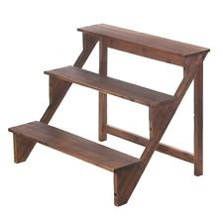
Displays/use of tables and shelves
Lifting the produce up off of the ground or the floor during marketing is a simple practice that will help to reduce postharvest losses.
Using tables or shelves for displays can ensure that produce is not stepped on or exposed to dust or pests.
Allowing air to pass under the display can help keep the produce cooler.
Simple display shelves (Photo credit: Lisa Kitinoja)
Mod. 1.4 Slide 83

Slide 85
Details on how to reduce losses for these key F&V crops in SSA:
Banana/Plantain
Mango
Papaya
Tomato/Hot peppers
Onions
Leafy greens
Green beans
Mod. 1.4 Slide 84

Slide 86
Improved postharvest handling, storage and marketing of Banana/Plantain
Harvest index: Fingers begin to fill out and become rounded (loss of angularity). Bananas and plantains are harvested mature-green.
Harvesting practices: Avoid early harvest, fruits will be small and light for their size, of lower market value. Handle bunches gently and avoid dropping the fruits.
Cleaning/trimming: Wash off latex (sap) if the hands are cut from the bunches. The water used to wash these fruits must be clean and sanitized (contain 200 ppm chlorine).
Storage: The optimum temperature for storage and transport is 13-14°C. Bananas and plantains are chilling sensitive.
Marketing: Bananas are often ripened before marketing to improve market value. The optimum temperature for ripening bananas is 15-20°C.
Mod. 1.4 Slide 85

Slide 87
Improved postharvest handling, storage and marketing of Mango/Papaya
Harvest index: Mangoes change in fruit shape (fullness of the cheeks) as they reach maturity. Papayas change in color from green to yellow or red. There are also internal color changes in flesh color from greenish-yellow to yellow to orange. Papayas are usually harvested at color break to ¼ yellow for export or at ½ to ¾ yellow for local markets.
Harvesting practices: Gentle harvesting, and avoiding drops and bruises.
Cleaning/trimming: Sap must be removed (washed off) immediately after mangoes are harvested. A dark-brown to black discoloration of mango skin is due to chemical & physiological injury from exudate (sap) from cut stem. The water used to wash these fruits must be clean and sanitized (contain 200 ppm chlorine).
Storage: Both mangoes and papayas are chilling sensitive. Optimum temperature is 13°C for mature-green mangoes and 10°C for partially-ripe and ripe mangoes.
Mod. 1.4 Slide 86
Notes:
See Manual 5b for more details.

Slide 88
Improved postharvest handling, storage and marketing of Tomatoes/hot peppers
Harvest index: These vegetables are harvested at various colors (maturities) depending upon the market demand and distance from the farm.
Harvesting practices: Gentle handling is required to reduce bruising and physical damage.
Fruits can be sorted to remove any decayed or damaged units, and graded by color or size during the harvesting process – and if packed directly into shipping containers in the field, this is called “field packing”.
Cleaning/trimming: A soft, clean cloth can be used to wipe the fruits clean. If water is used to wash these fruits it must be clean and sanitized (contain 200 ppm chlorine).
Storage: Tomatoes and peppers are chilling sensitive. Optimum temperature is 18 to 20 °C for mature-green tomatoes and 15°C for partially-ripe and ripe tomatoes. Peppers store best at temperatures of 7 to 13°C.
Mod. 1.4 Slide 87

Slide 89
Improved postharvest handling, storage and marketing of Onions
Harvest index: tops beginning to dry out and fall down
Harvesting practices: Undercut (break roots) and allow onions tops to completely dry down. Lift bulbs carefully and shake to remove loose soil.
Curing: Make windrows in the field (short long piles) and cover the onions with dry tops. Allow to dry (cure) for up to 7 days before further handling or packing.
Cleaning/trimming: Remove loose foliage, dried leaves should fall off or can be pulled off easily.
Long term storage: The optimum storage temperature for onions is 0°C and for long term storage onions require low relatively humidity (65-70%). Depending upon the variety, onions can be stored from 1 to 8 months.
Mod. 1.4 Slide 88

Slide 90
Improved postharvest handling, storage and marketing of Leafy greens
Harvest index: Adequate size
Harvesting practices: Manually harvest larger outer leaves for vegetables grown for multiple harvests. Alternatively, cut or pull up the whole plant for a single harvest.
Cleaning/trimming: Remove any broken or bruised leaves. Some leafy greens are bunched before packing. This practice needs to be done very gently, using a smooth twine or cord.
Field containers: Use of protective containers such as stackable ventilated plastic crates can reduce compression damage and bruising during transport. Liners in rough containers (baskets or wooden crates) can reduce abrasion damage.
Storage: Leafy vegetables are highly perishable and are typically not stored for more than a few days, unless very cold temperatures can be provided. Spinach and chards, for example, can be stored for 2 weeks at 0°C.
Mod. 1.4 Slide 89

Slide 91
Improved postharvest handling, storage and marketing of Green beans
Harvest index: Green beans (also known as French bean, haricot vert, and string bean) can be harvested when the pods are well filled but before seed bulges appear.
Harvesting practices: Green beans are manually harvested. Indeterminate varieties should be continuously harvested (every day or two days).
Field containers: Use of protective containers such as plastic crates can reduce compression damage and bruising during transport. Liners in rough containers (baskets or wooden crates) can reduce abrasion damage.
Storage: Green beans are rarely stored for more than a few days. They are chilling sensitive and the lowest safe temperature is 7 °C.
Mod. 1.4 Slide 1

Slide 92
Technical information on other F&V crops
USDA Handbook 66. 2014. http://www.ba.ars.usda.gov/hb66/title.html
Produce Fact Sheets http://postharvest.ucdavis.edu/Commodity_Resources/Fact_Sheets/
Mod. 1.4 Slide 91

Slide 93
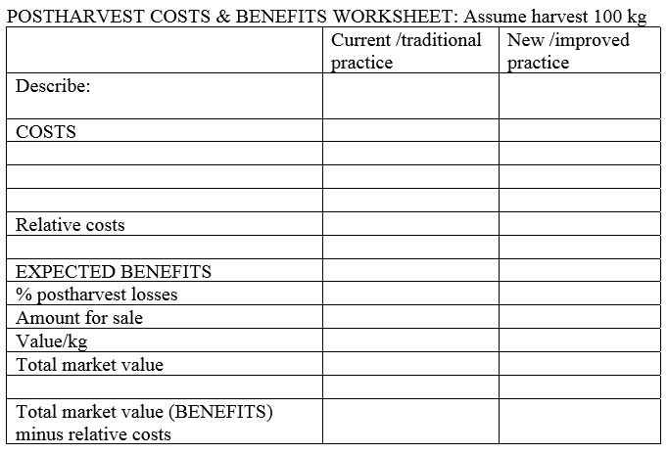
Costs and benefits
It is easy to learn how to use a simple worksheet to calculate the local costs and expected benefits for any new or improved practice or technology by estimating relative changes in comparison to the current practice or technology.
Using 100kg to make the calculations allows the user to perform easy math, then multiply the results by whatever volume will actually be harvested/handled and sold.
Mod. 1.4 Slide 92

Slide 94
Cost/Benefit examples
1. Fruits – bananas: Plastic crates for packing washed hands, transport and marketing
Often a produce farmer, handler or trader will hesitate to make investments in extra labor or improved containers, but for many crops, including bananas, the investment will pay off immediately due to reduced loses and higher market prices.
2. Vegetables – hot peppers: Harvesting at red stage, sorting/grading and packing in plastic crates for transport and marketing
Plastic crates can be an expensive investment for small farmers and traders, but if the crop can be protected from damage, the returns can be enough to pay for the investment in a single use. For hot peppers, the price for firm, red ripe peppers can be twice the value as that for green or mixed lots of peppers.
Mod. 1.4 Slide 93

Slide 95
C/B Example 1: Bananas packed in plastic crates
Mod. 1.4 Slide 94

Slide 96
C/B example 2: Hot peppers – sorting and packing in plastic crates
Mod. 1.4 Slide 95

Slide 97
Priority training needs
Topics that need attention in order to solve postharvest problems for a variety of fruits and vegetable crops
Use of proper maturity indices
Basic improved postharvest handling practices (avoiding damage)
Use of improved containers in order to reduce damage
Temperature management and relative humidity control
Postharvest pest and disease management
Mod. 1.4 Slide 96

Slide 98
Gender aspects for postharvest training
There are certain postharvest topics that may be of special interest for women who handle F&V crops (Kitinoja and Barrett 2015):
Using apron-like harvest bags to pick fruit from trees, or for harvesting row crops like peppers or tomatoes. Women can make these bags themselves, and find the picking bags easy to manage. Drudgery is reduced, as there is much less bending and lifting in the field
Using smaller containers for harvesting and farm work. This can make the workload easier for women, and it is also good for the crops since using a smaller crate, sack or basket will reduce physical damage
Using smaller containers for transport. This will reduce the weight of head-loads, and cause less produce damage and lower postharvest losses
Sanitation from farm to kitchen. This includes food safety for handling fresh produce plus useful practices for keeping the kitchen cleaner and healthier
Mod. 1.4 Slide 97

Slide 99
Advocacy issues
Problems that require attention in order to reduce postharvest losses for a variety of fruits and vegetable crops
Improving infrastructure (roads, power, water)
Investing in postharvest facilities (packinghouses, storage structures, cool trucks)
Establishing a system for the use of returnable plastic crates (cleaning, repairing and returning empties to producers)
Investing in agro-processing (SMEs) for juices, bottled products, canning, aseptic packaging, dried F&V products
Improved marketing (facilities, farmer/trader organizations, cooperatives)
Providing incentives for using improved postharvest practices and investments
Mod. 1.4 Slide 98

Slide 100
End of Module 1.4
This concludes Module 1.4 on Reducing Postharvest Losses in Sub-Saharan Africa: Fruits and Vegetables
Manual 1 contains a full reference list for practitioners.
Mod. 1.4 Slide 99

